Slide 1
…They are precious in His sight

Slide 2
Jesus loves the little children…

Slide 3
Frederic Gray: Being one – if the Adam and Eve story is true, then why are there so many races? (10/02/12) Power – politics – pernicious one
Notes:
Frederic went through a HISTORICAL, BIOLOGICAL, then BIBLICAL look at “race”.

Slide 5
Jesus loves the little children…
“BROWN AND BROWN, AND BROWN AND BROWN”

Slide 6
Looking at our fellow man through the eyes of God
1 Samuel 16:7 – For the Lord sees not as man sees:
Man looks on the outward appearance.
God looks on the heart.

Slide 7
Do we have the ”eyes” of God?
He created diverse “families” (“kinds”) of creation: Stars, clouds, animals, birds, creeping things, rocks, snow-flakes, sunsets, mountains and valleys, foods, etc., etc., etc.
Instead of being threatened by God’s creation we should celebrate how such diversity reveals the “manifold” creativity of God!

Slide 8
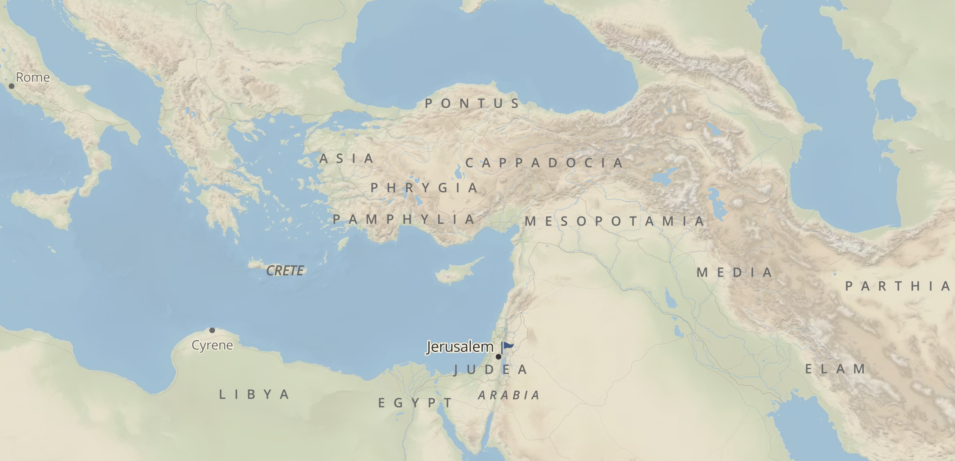
Celebrating God’s Creative Image: Acts 2

Slide 9
One Lord, one faith… (Ephesians 4:1ff)
Yet, many expressions of our ONE FAITH
Many expressions on how to love our ONE LORD
In the cultural expressions of worship
In the expressions of loving our neighbor
Or, simply ways of living life: dress, foods, songs, architecture, etc.

Slide 10
We’re only threatened by the Pernicious one
He is the one who divides: through Power/Politics
Whatever can be used to drive us apart: “superior/inferior” (think “red”, “yellow”, “black” vs. “white”)*
Power/Politics don’t address the heart of sinful man.
But the answer to Satan: Christ (and His gospel) who unites us in/through Him. Galatians 3:26-29
Notes:
* Wednesday night Bible class

