Slide 2
October 31st All Hallow’s Eve
It was also on this day (1517) that Martin Luther delivered his protest (“95 theses”) to the Catholic church which began the Protestant reformation.
While mostly neglected by many practicing Christianity what is important for us today is that many have passed the veil of this side of eternity in their walk with God.

Slide 3
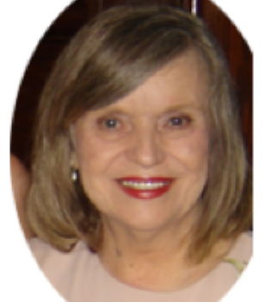
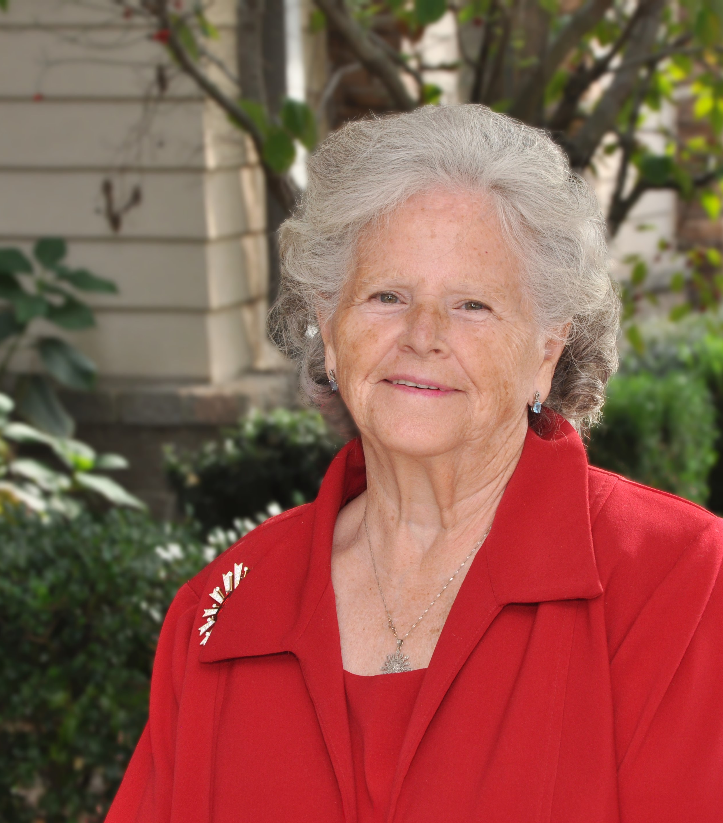
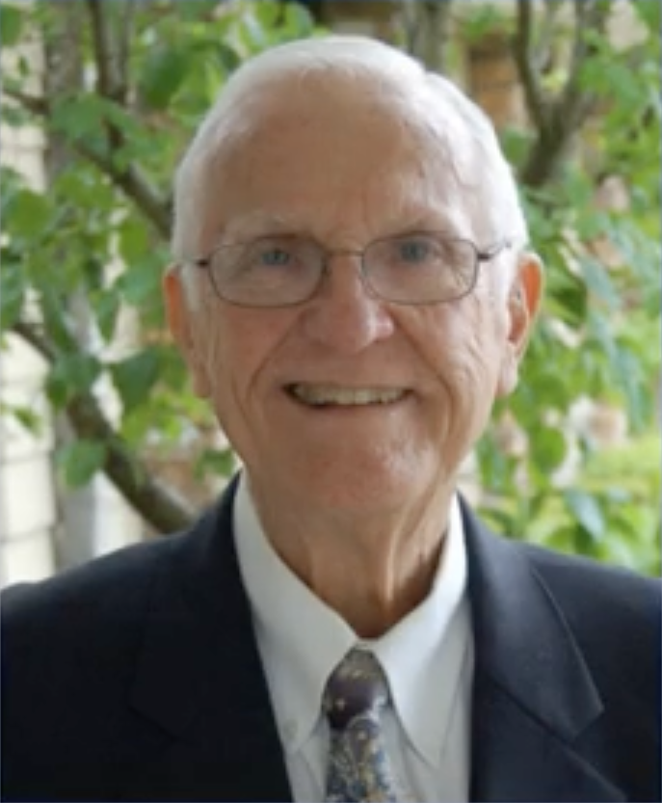
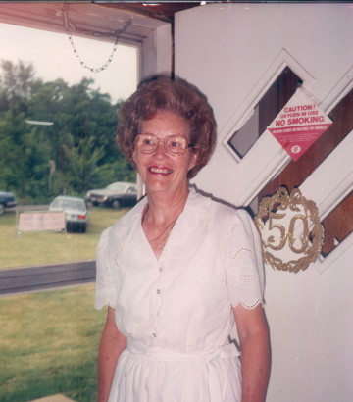
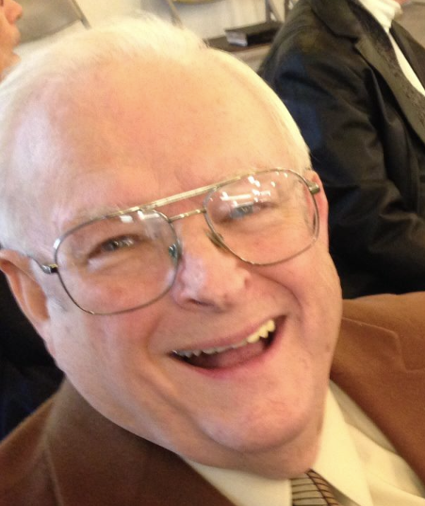
The last 12 years
Luther (2010) and Margaret Smithson (2012)
Opal Blankenship (2011)
James “Jimmy” Hickman (2011)
Janie Reed (2013)
Mark Chilcote (2014)
Charles Thurman (2014)
Sue Claytor (2015)
Clay & Sharon Joseph (2015)

Slide 4
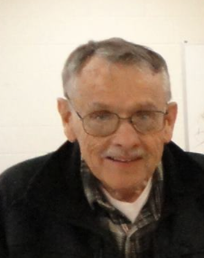
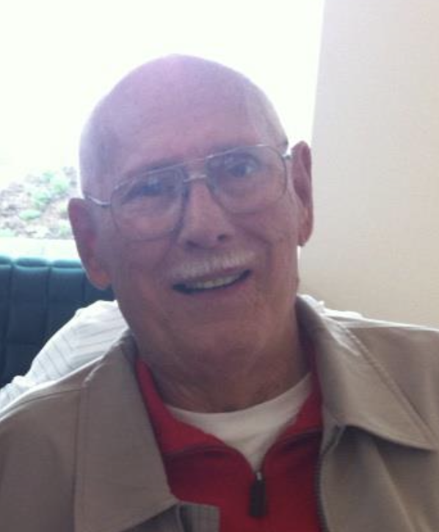
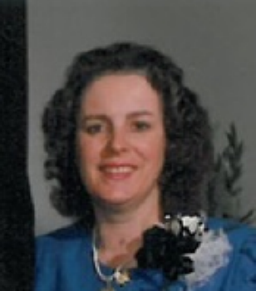
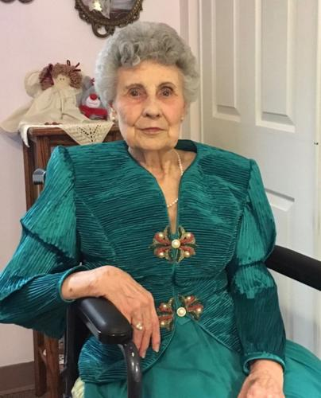
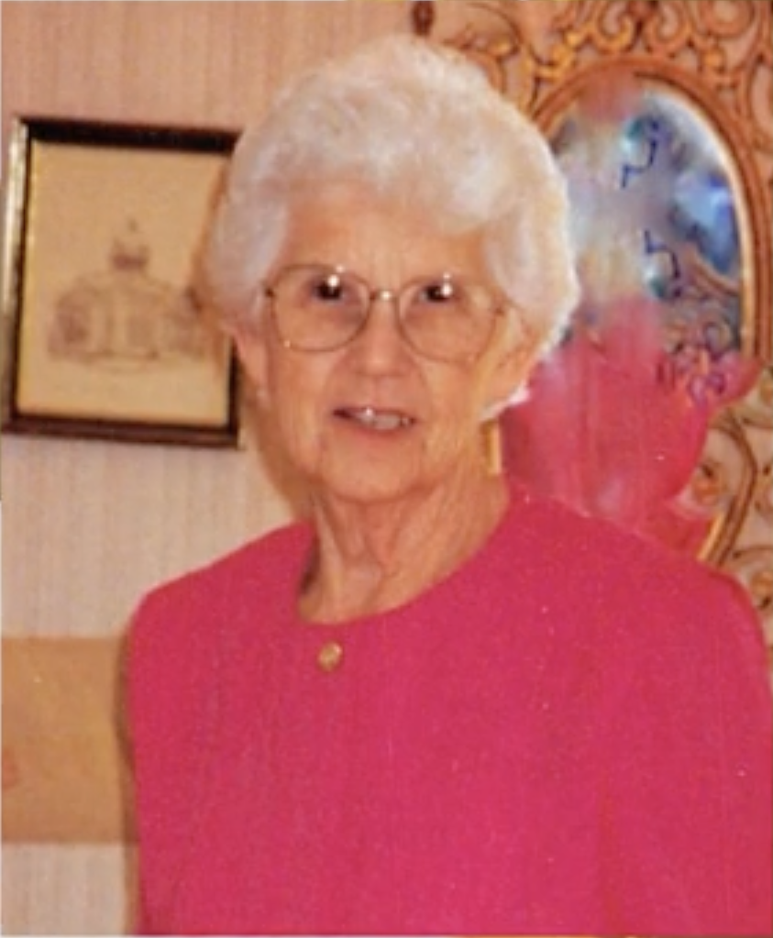
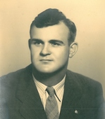
The last 12 years
Charles McCann (2015)
John (2017) and Betty Francis (2015)
Luke Hughey (2016)
Herk Norris (2017)
Jim Dark (2018)
Julia Holt (2018)
Odell Garrett (2018)
Carolyn Holland (2018)
Loretta Nash (2019)

Slide 5
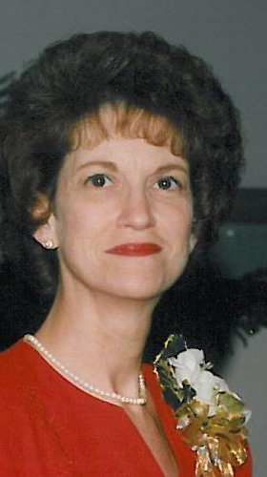
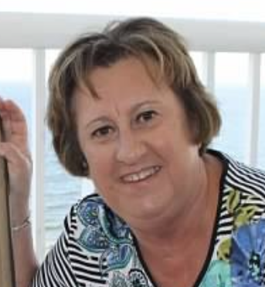
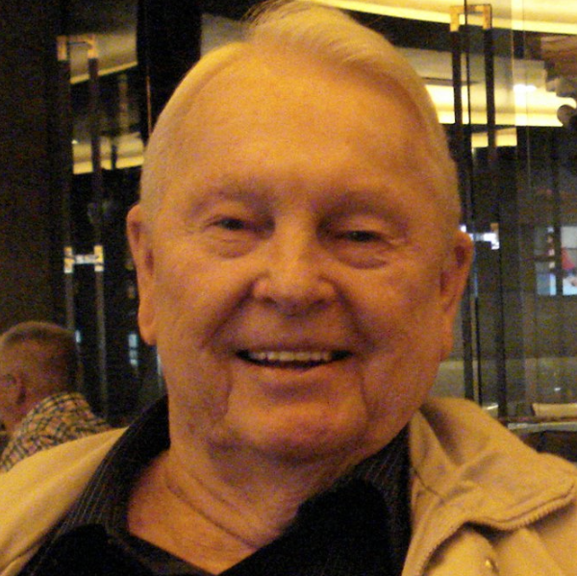
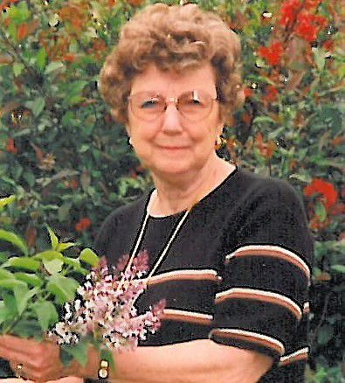
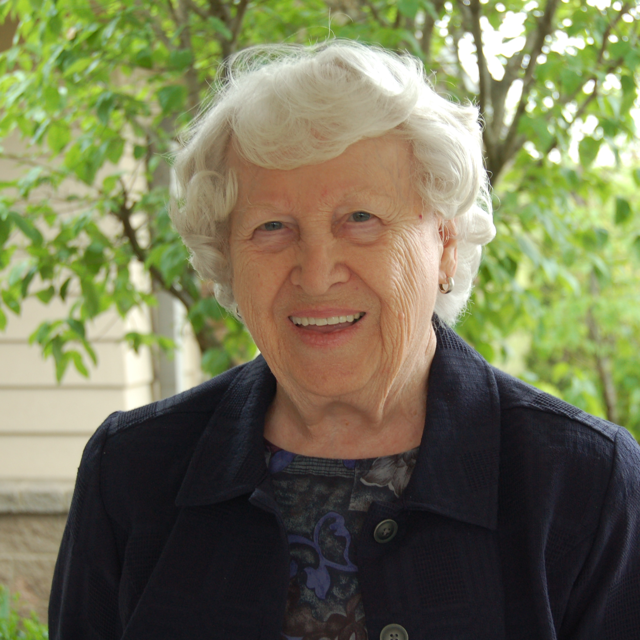
The last 12 years
Arthur Witt (2019)
Paulette Coleman (2019)
Doris Eades (2019)
Kathy Eades (2020)
Lou Hulme (2020)
Sheila Cather (2020)
Harriet Jenkins (2021)
Brenda Wells (2021)
Mary Warnke (2021)

