Slide 1
Living Your Best Life

Slide 2
EVERYONE wants the very BEST in life
We REASON/ JUSTIFY each decision to make it happen.
It is the epitome statement of our desire to have the best life.

Slide 3
The PROBLEM? Our decisions don’t always turn out to be what we thought/ hoped would be best for us/others

Slide 4
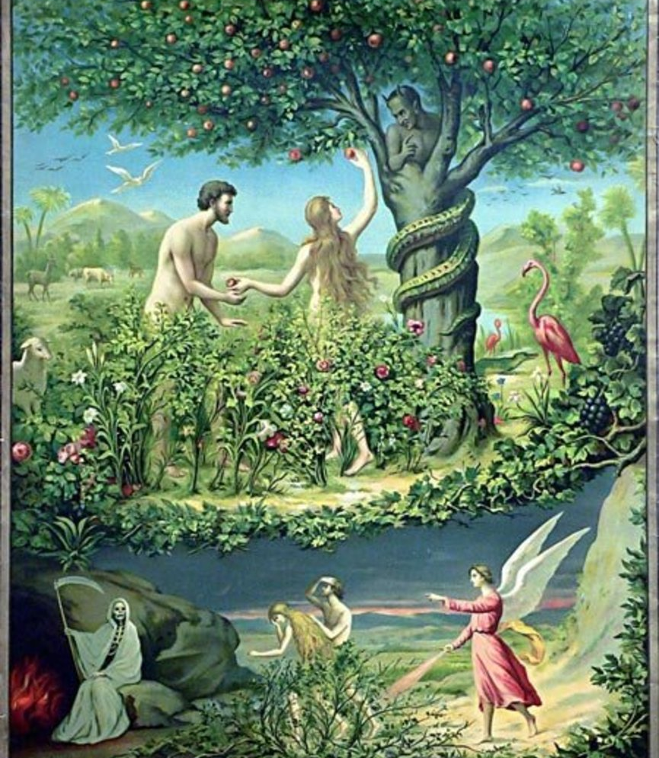
This problem has been with us from the beginning
Genesis 2:15-17; 3:5-7

Slide 5
Case study: Reuben, Gad, ½ Manasseh
Numbers 32 1 Chron 5:18-22; 23-26

Slide 6
We don’t see with an eternal perspective
We often don’t look past our own life; or the lives of loved ones, let alone the well-being of strangers.

Slide 7
God’s View
Man’s View
Past
Limited
Future

Slide 8
How do we live our “best life”?

Slide 9
Grow in knowing God’s grace and knowledge. 2 Pet 3:8-18
Know that “if the Lord wills we shall live and do this or that”. James 4:15

