Slide 1
What does it mean to take the name of the Lord in vain?

Slide 2
Elohim = God, gods
“God”or “elohim” refers to spiritual beings:
Who we call “God” is the Creator (spiritual being).
“gods” are created (spiritual beings).
Ways elohim is translated
Most notably: God (the Creator of all)
1x as “angels”. Psa 8:5
Room/house of gods or “bet elohim”. Judg 17:5
A spirit (Samuel). 1 Sam 28:13

Slide 3
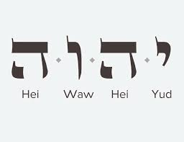
The Tetragrammaton
YHWH: is the name of the spiritual being who “made the earth and the heaven”. Gen 2:4
These letters (YHWH) are based upon the Hebrew “4 Letters” (Greek: Tetragrammaton)
This is how our God declared His “Name”. Exo 3:13-14; Exo 6:2-3
NOTE: how translators differentiate between
Lord vs. Lord

Slide 4
Exodus 20:7 “Do not take the name of the Lord your God in vain”
Take(ing) the name = bear(ing) the name
Vain also translated as worthless, false, futile, useless or wicked.
In other words = The commandment not taking/bearing the name of God in a worthless or wicked manner.

Slide 5
Examples
Cursing the name of YHWH. Leviticus 24:13-16
Swear an oath by/in His name. Lev 19:12 (Deut 18:20-22)
Doing wickedness. Lev 18:21; Lev 22:1-2; Mal 1:10-14
While the first two are gravely important, this last point is one many Christians do not take as gravely but is JUST AS vital to our walk with God.

Slide 6
The Why
“To know the name YHWH, the merciful and gracious one, is not to merely know something about God; it is to know God himself (Ex. 34:6–8). God shows himself by speaking his name.” cp. Matt 6:9
So, take the name of God (and “Jesus”) with you wherever you go… solemnly as you represent Him!

