Slide 1
The lost art of gentleness

Slide 2
We live in angry times…
Cancel culture
Conniption Karens
Hatred for the other political party
How did we get here?

Slide 3
The pushback against gentleness
Weak
Lacking urgency
Not serious enough

Slide 4
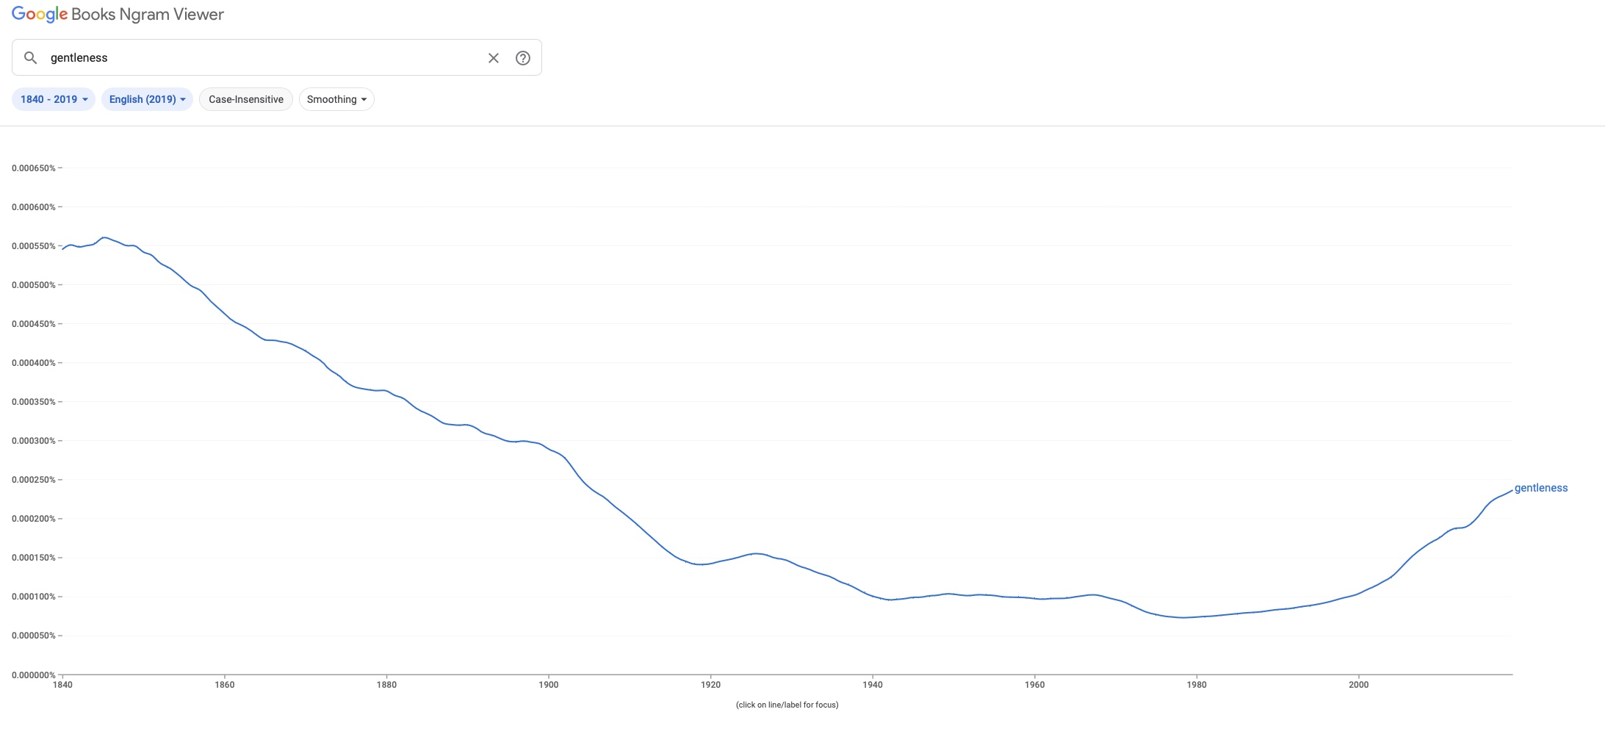
The downward trend of gentleness has affected the church

Slide 5
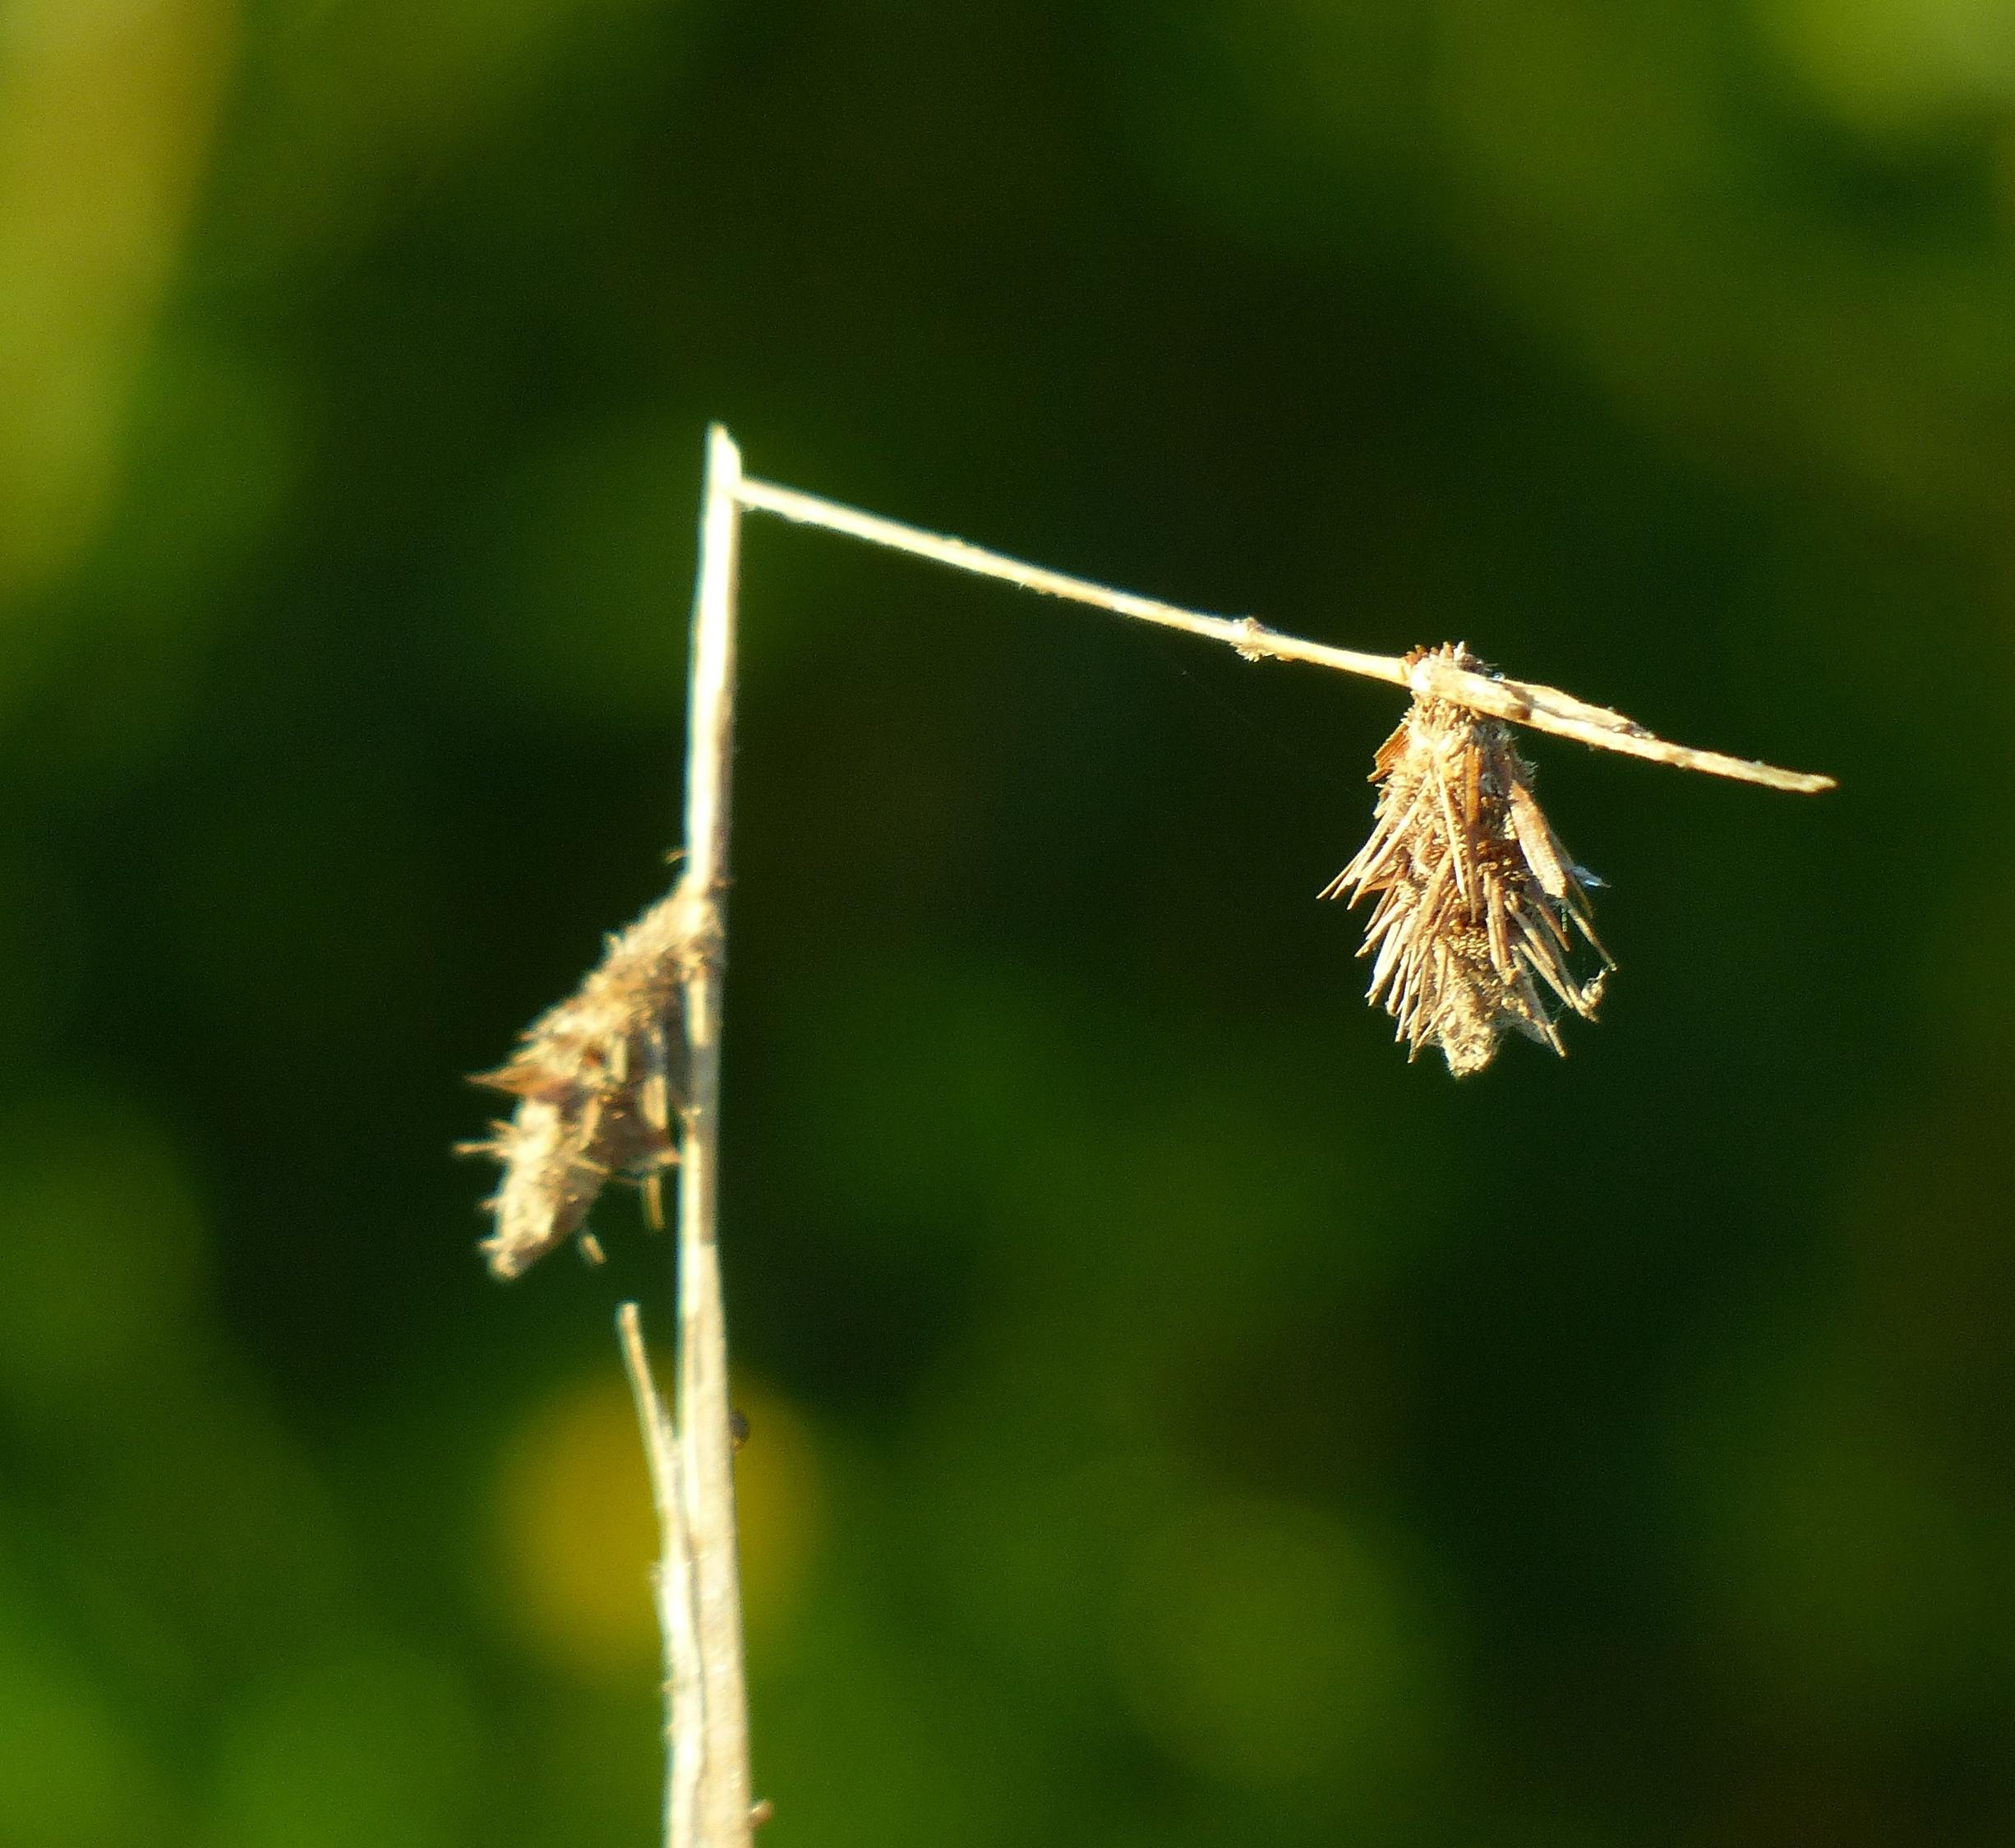
Gentleness is NEEDED in the church
So many people are hurting and in distress
So many are struggling in life
So many need the salve of salvation.
A bruised reed He will not break
Isaiah 42:3

Slide 6
The biblical call to gentleness
Gentleness does NOT dismiss when the rod may be needed. 1 Cor 4:21
This is divine fruit. Gal 5:23
The way to restore a fellow believer. Gal 6:1
The way to walk worthy in Christ. Eph 4:1-2
The way to lead in the church. 1 Tim 3:3
Is coupled with divine wisdom. Jas 3:7

Slide 7
The effect of biblical gentleness
Many feel safe and trust those who are gentle.
Many feel valued by those with a gentle spirit.
Those who practice it reveal a beautiful image of Jesus
He will tend his flock like a shepherd; he will gather the lambs in his arms; he will carry them in his bosom, and gently lead those that are with young.
Isa. 40:11

Slide 8
The gentle invitation
Come to Me, all you who labor and are heavy laden, and I will give you rest. Take My yoke upon you and learn from Me, for I am gentle and lowly in heart, and you will find rest for your souls.
Matthew 11:29

