Slide 1
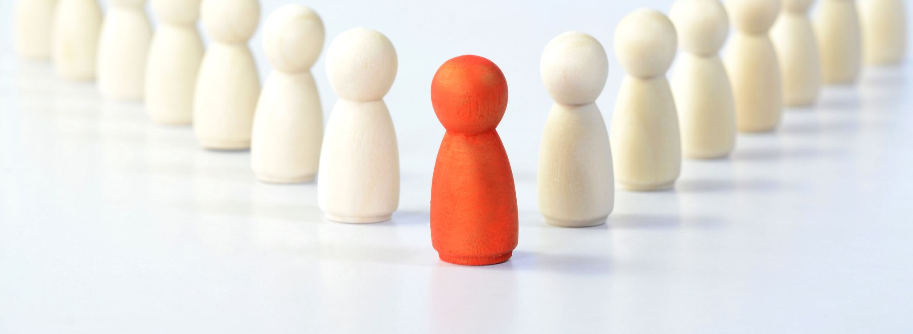
Follow Jesus
Making Disciples the way Jesus made Disciples (Matt 8-13)

Slide 2
The kingdom of righteousness
Kingdom announced:
Change the way you live: the kingdom is at hand. Matt 4:17
Come into the kingdom/that you can share it with others. Matt. 4:18
Good hearts CHANGED into good lives. Matt 5-7

Slide 3
Jesus’ Kingdom shared (Matthew 8-10)
He healed
Leper. 8:1
He ruled
Physical realm. 8:23
Centurion’s servant. 8:5
Peter’s MIL. 8:14
“Follow Me”
Matt 8:18
Spiritual realm. 8:28
Both. 9:1
"Follow Me"
Matt 9:9
He restored
Life. 9:18
Sight. 9:27
Speech. 9:32
Those who followed Him did what He did. Matthew 10

Slide 4
People’s reactions to Jesus
Maybe: Is He the Messiah? 11:3
Rejection: He is NOT the Messiah! 11:16ff
Positive: He is the Messiah! 12:46ff

Slide 5
Following Jesus
Help the helpless
1
Exercise righteous dominion
2
Restore people
3

Slide 6
Reacting to how people react to you
People are reacting to you as they did Jesus: positive, maybe, rejection. Matthew 10:24
Be a good neighbor: seek personal relationships
Ask questions: deepen your relationships
Listen when they become vulnerable
Value them (their story: good/bad/ugly)

