Slide 1
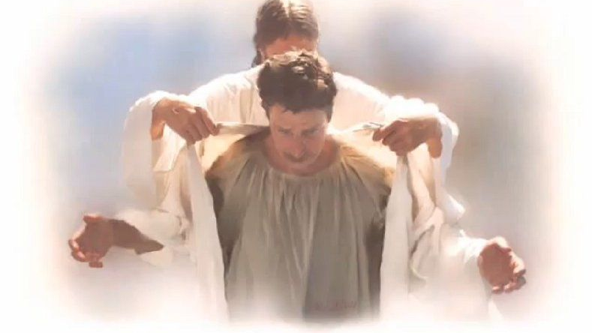
Becoming the righteousness of God through Jesus

Slide 2
Going from sinners to being the righteousness of God
Zeal for God “without knowledge” of “God’s righteousness”… leads to self-righteousness.
The “righteousness of God” is found
only through faith in Jesus Christ.
Romans 10:3-4
Let’s see how the “righteousness
of God” is attained through Christ.

Slide 3
The gospel reveals the righteousness of God
Romans 1:16-18
The bad news (for mankind) is that God’s righteousness condemns sin.
Rom 1:18ff (Rom 3:23; 6:23)
The good news is that His righteousness
is also revealed through the
message of the cross. Rom 1:16-17

Slide 4
Man’s unrighteousness commends the righteousness of God
God’s wrath came upon all ungodliness. Rom 1:18ff
God gave His covenant people (Israel) the “oracles” of righteous living. Rom 3:1-6
Still, apart from the law God’s
righteousness was revealed…
through faith in Jesus.
Rom 3:21-22

Slide 5
He made Him who knew no sin to be sin on our behalf, so that we might become the righteousness of God in Him. 2 Cor 5:21

Slide 6
If we are the righteousness of God… how shall we live?
Blessed are those who “hunger and thirst for righteousness”. Matt 5:6
Remember ALWAYS though that
“by (God’s) doing (we) are in
Christ Jesus, who became to us
wisdom from God, and
righteousness… so that if we boast ,
we boast in the Lord. 1 Co 1:30-31

