Slide 1
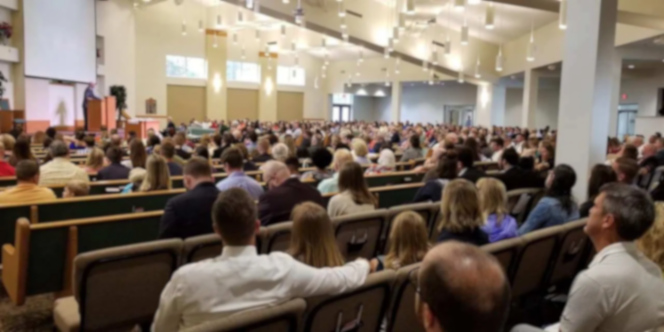
Why we sing in church
A biblical and historical look at a cappella worship

Slide 2
Preconceived Idea #1: Instrumental Music in the N.T. church IS authorized..
THEREFORE: Find all the passages, arguments, and quotes in favor of showing instrumental music being authorized in the New Testament worship.

Slide 3
Preconceived Idea #2: Instrumental Music in the N.T. church IS NOT authorized..
THEREFORE: Find all the passages, arguments, and quotes against showing instrumental music being authorized in the New Testament worship.

Slide 4
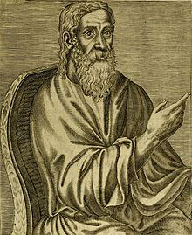
Clement of Alexandria “If a man learns without preconceived ideas, he has ears to hear the truth.”

Slide 5
Why the words of Clement of Alexandria matters
Because EVERYONE has preconceived ideas, making learning the truth difficult.
Because “preconceived ideas” will keep our eyes closed to the truth.
When intentionally learning “without preconceived ideas” success at learning the truth can be achieved.

Slide 6
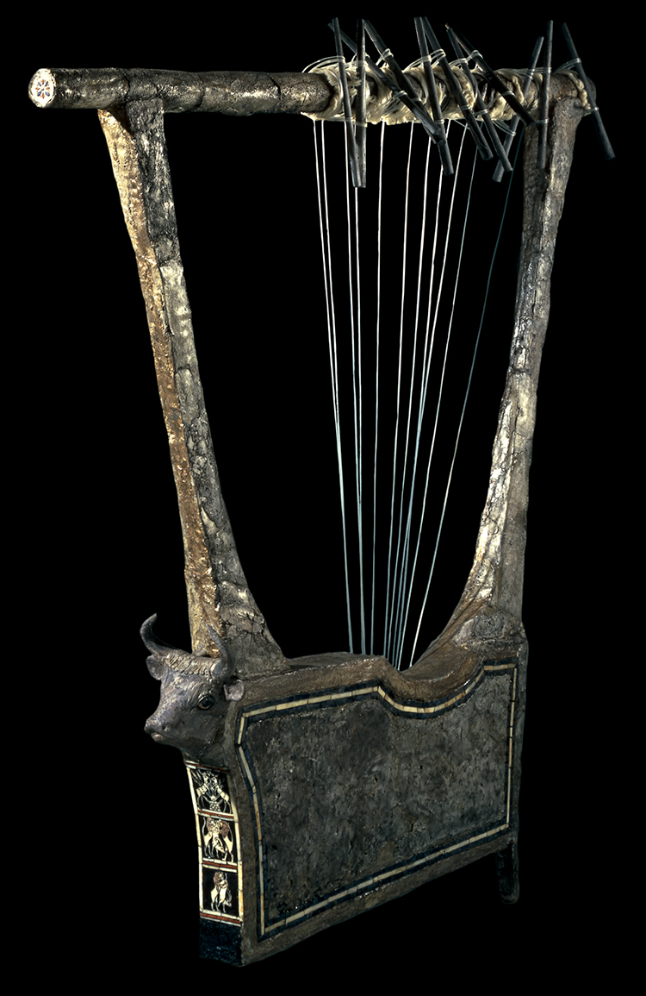
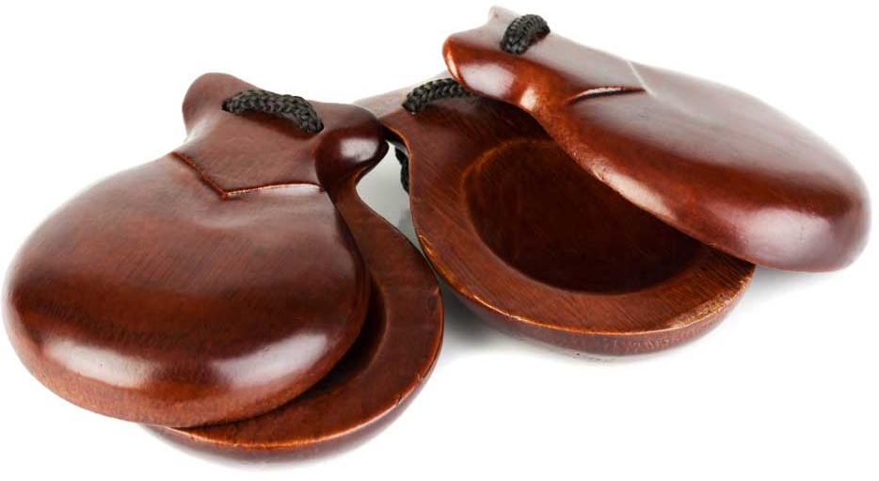
Old Testament
Jubal: father of all those who played the harp and flute. Gen 4:21
Linked to festivities. Gen 31:27
Connected to worship and prophesying. 1 Sam 10:5; 2 Sam 6:5; 1 Ki 10:12

Slide 7
Psallo: how it is translated in the LXX (O.T. Greek)
Judges 5:3
“Hear, O kings! Give ear, O princes! I, even I, will sing to the Lord; I will sing praise to the Lord God of Israel.
It can mean “sing”. Jdg 5:3
It can mean “play”. Psa 68:25
Sometimes its hard to tell. Psa 33:3
Notes:
Some reliance of etymology based on Everett Ferguson’s “A Cappella Music In the Public Worship of the Church
Image: Italian Lute from 1,000 B.C.

Slide 8
Psallo: how it is translated in the LXX (O.T. Greek)
Psalm 68:25
“The singers went before, the players on instruments followed after; Among them were the maidens playing timbrels.”
It can mean “sing”. Jdg 5:3
It can mean “play”. Psa 68:25
Sometimes its hard to tell. Psa 33:3
Notes:
Some reliance of etymology based on Everett Ferguson’s “A Cappella Music In the Public Worship of the Church
Image: Italian Lute from 1,000 B.C.

Slide 9
Psallo: how it is translated in the LXX (O.T. Greek)
Psalm 33:3
“Sing to Him a new song; Play skillfully with a shout of joy."
It can mean “sing”. Jdg 5:3
It can mean “play”. Psa 68:25
Sometimes its hard to tell. Psa 33:3
Notes:
Some reliance of etymology based on Everett Ferguson’s “A Cappella Music In the Public Worship of the Church
Image: Italian Lute from 1,000 B.C.

Slide 10
New Testament
Linked to mourning death. Matt 9:23
Linked to heavenly worship.
Use of harps singing “a new song”. Rev 5:8-9; Rev 14:2-3
Celebration of victory. Rev 15:2

Slide 11
Psallo: in the New Testament
Romans 15:9
“…“For this reason I will confess to You among the Gentiles, and sing to Your name.”
Exclusively referred to as “sing”. Rom 15:9; 1 Cor 14:15; Jas 5:13
“Making melody” may connote ”play” (of the heart) but tied to singing. Eph 5:19 (Col 3:16-17)
Notes:
Some reliance of etymology based on Everett Ferguson’s “A Cappella Music In the Public Worship of the Church
Image: Italian Lute from 1,000 B.C.

Slide 12
Psallo: in the New Testament
1 Corinthians 14:15
“What is the conclusion then? I will pray with the spirit, and I will also pray with the understanding. I will sing with the spirit, and I will also sing with the understanding.”
Exclusively referred to as “sing”. Rom 15:9; 1 Cor 14:15; Jas 5:13
“Making melody” may connote ”play” (of the heart) but tied to singing. Eph 5:19 (Col 3:16-17)
Notes:
Some reliance of etymology based on Everett Ferguson’s “A Cappella Music In the Public Worship of the Church
Image: Italian Lute from 1,000 B.C.

Slide 13
Psallo: in the New Testament
James 5:13
“Is anyone among you suffering? Let him pray. Is anyone cheerful. Let him sing psalms.”
Exclusively referred to as “sing”. Rom 15:9; 1 Cor 14:15; Jas 5:13
“Making melody” may connote ”play” (of the heart) but tied to singing. Eph 5:19 (Col 3:16-17)
Notes:
Some reliance of etymology based on Everett Ferguson’s “A Cappella Music In the Public Worship of the Church
Image: Italian Lute from 1,000 B.C.

Slide 14
Psallo: in the New Testament
Ephesians 5:19
“…speaking to one another in psalms and hymns and spiritual songs, singing and making melody in your heart to the Lord,”
Colossians 3:16
Let the word of Christ dwell in you richly in all wisdom, teaching and admonishing one another in psalms and hymns and spiritual songs, singing with grace in your hearts to the Lord.
Exclusively referred to as “sing”. Rom 15:9; 1 Cor 14:15; Jas 5:13
“Making melody” may connote ”play” (of the heart) but tied to singing. Eph 5:19 (Col 3:16-17)
Notes:
Some reliance of etymology based on Everett Ferguson’s “A Cappella Music In the Public Worship of the Church
Image: Italian Lute from 1,000 B.C.

Slide 15
Be careful when quoting extra-biblical sources. Example from Clement of Alexandria
“The Word of God, despising the lyre and harp, which are but lifeless instruments…. For thou art my harp, and pipe, and temple.”
“Teaching and admonishing one another in all wisdom, in psalms, and hymns, and spiritual songs, singing with grace in your heart to God.” And again, “Whatsoever ye do in word or deed, do all in the name of the Lord Jesus, giving thanks to God and His Father.” This is our thankful revelry. And even if you wish to sing and play to the harp or lyre, there is no blame.”

Slide 16
Through His silence, God hasn’t given us authority to use instruments in the New Testament
DO NOT presume that we have authority for such in the N.T. cp. Chron 29:25
DO NOT presume God will eternally condemn those who use them.
BOTTOM LINE: Let us “speak where the Bible speaks and to be silent where it is silent.”

