Slide 2
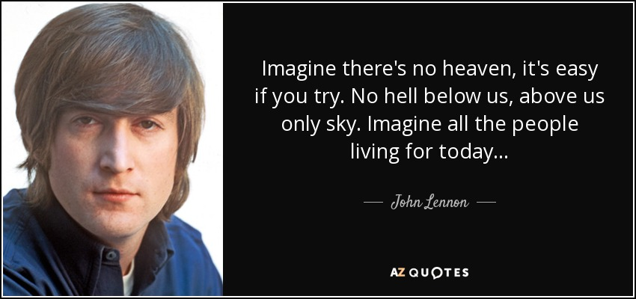

Slide 3
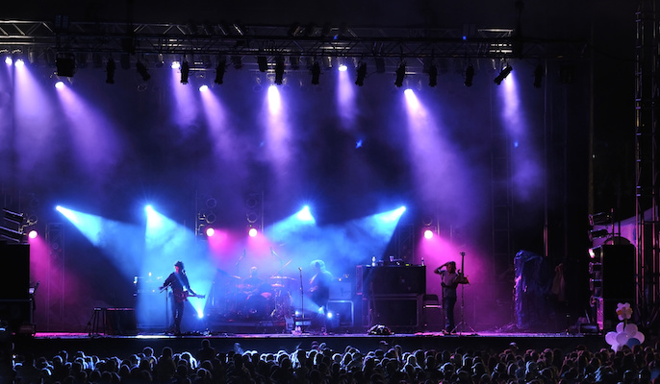

Slide 4
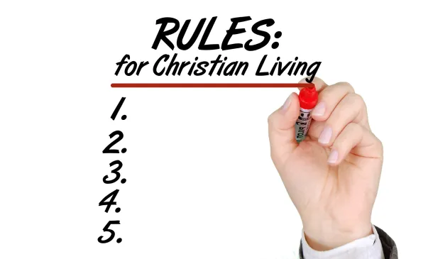

Slide 5
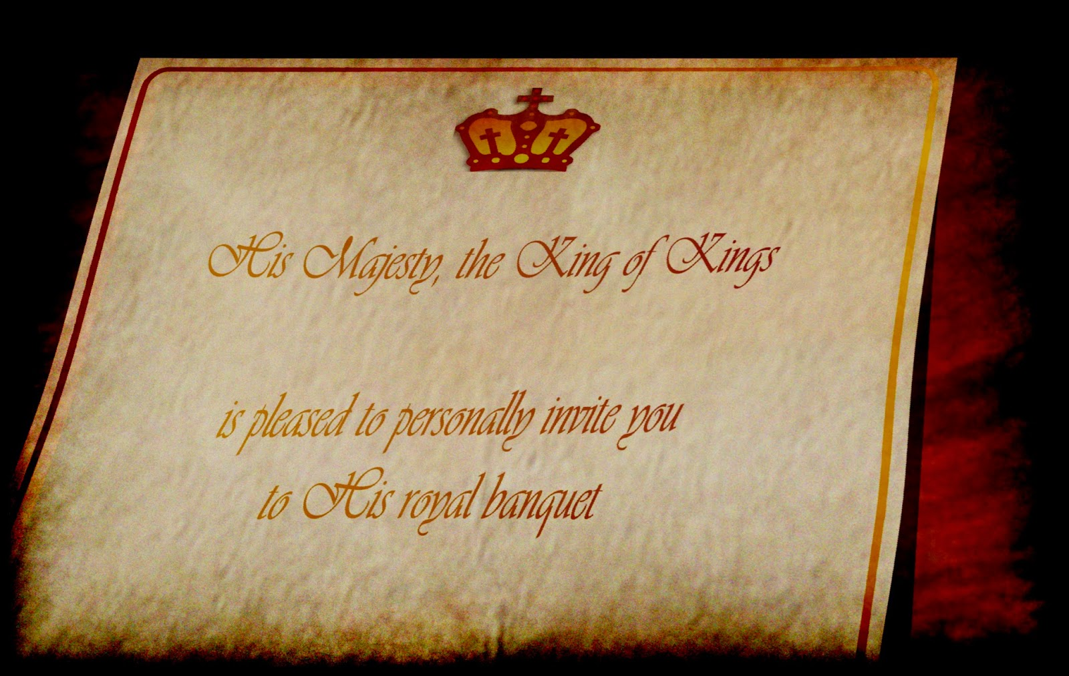
Matthew 22:1-14

Slide 6
The king’s marriage feast for His son
Servants called all who had been invited. vs. 2-6
After rejecting/killing His servants the king destroyed the murderers… v. 7
Servants then called any (good and bad) to the wedding feast. vs. 8-10 (see also Matt 21:32)
One was removed from the feast for not having his “wedding garment”. vs. 11-13 (see also Matt 21:43)

Slide 7
The wedding feast = kingdom of God
In rabbinic parables the king = God.
The wedding banquet = “marriage supper of the Lamb”. Revelation 19:9
Contextual Points of the Parable:
Pharisees (and other groups) rejected the Messiah. Matt 22:15 (see also Matt 21:45)
Another was not properly clothed… this is the focus for the remainder of the lesson.

Slide 8
Dress code for heaven

Slide 9
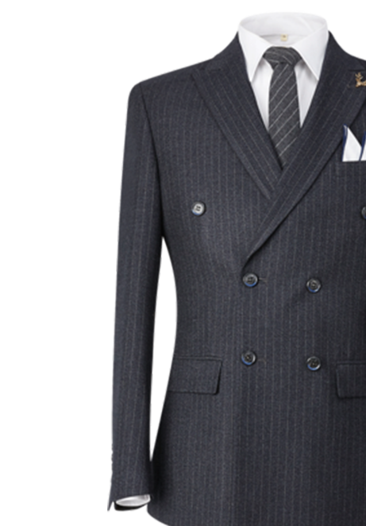
Clothed for the feast
Those who enter must be clothed according to the king: not according to our own standards.
Whether it be baptism (Clementine).¹ Gal 3:27
Works: love, grace, humility, etc. (Tertullian, Augustine, etc.). 1 Pe 5:5 (1 Tim 2:9)
Notes:
1. Dress Code for Heaven? Exploring the Textures of the Parable of the Royal Wedding Feast (Matt 22:1–14) https://researchoutput.csu.edu.au/ws/portalfiles/portal/71941811/Ruth_Mathieson_Thesis.pdf

