Slide 1
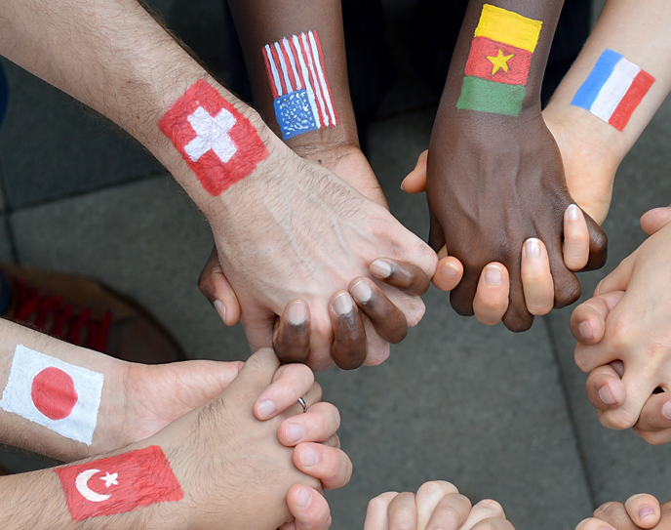
Appreciating Diversity within God’s Kingdom
Revelation 7:9-10

Slide 2
Diverse views on “diversity”
Views of diversity over the decades in our country:
Desegregation
Affirmative action
Inclusivity
What we strive for is a beautifully biblical view of diversity and to appreciate it.

Slide 3
Diversity in God’s creation
Consider all the “kinds” of creations there are in this universe. Then, think of the diversity within EACH KIND…from the microscopic to “immeasurable"!

Slide 4
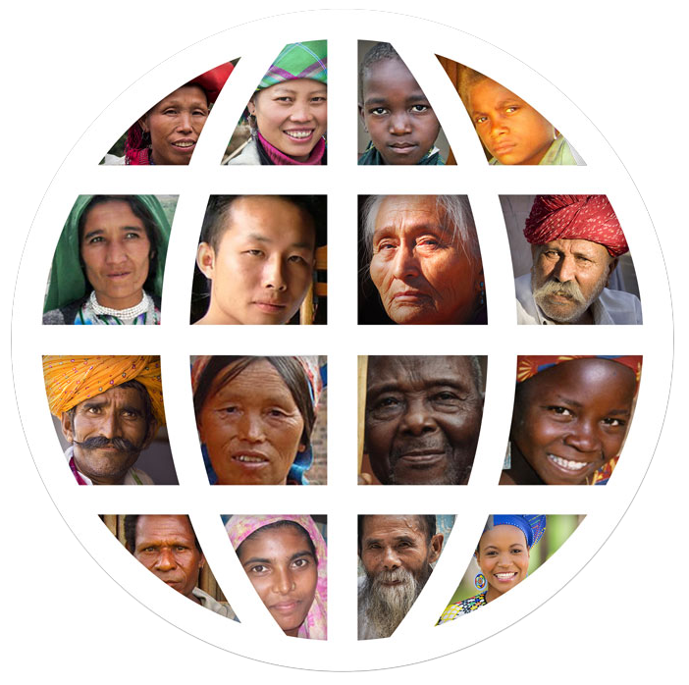
God’s Kingdom was meant to be diverse
“Go into all the world and make disciples…”
Matthew 28:19

Slide 5
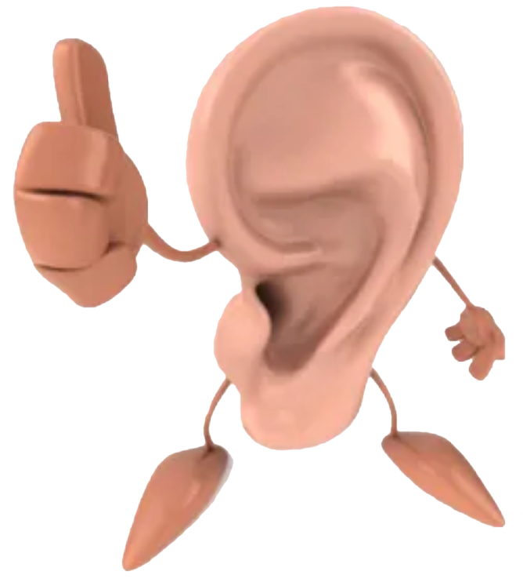
How boring would the body of Christ be if it looked like this?
And if the ear should say, “Because I am not an eye, I am not of the body,” is it therefore not of the body? If the whole body were an eye, where would be the hearing? If the whole were hearing, where would be the smelling? But now God has set the members, each one of them, in the body just as He pleased. And if they were all one member, where would the body be?
1 Corinthians 12:17-19

Slide 6
Appreciating the vast diversity that make up God’s kingdom
“…to the intent that now the manifold wisdom of God might be made known by the church to the principalities and powers in the heavenly places…”
Ephesians 3:10
Male and female
Young and old
Ethnicities
Cultures; sub-cultures
Individuals
Genesis 1:26

Slide 7
Appreciate our differences in Christ
Don’t be afraid of our differences. Instead embrace how each individual, gender, age, ethnicity, or culture contributes:
To the worship of our Lord
To the service in His kingdom

Slide 8
Revelation 7:9-10
“After these things I looked, and behold, a great multitude which no one could number, of all nations, tribes, peoples, and tongues, standing before the throne and before the Lamb, clothed with white robes, with palm branches in their hands, and crying out with a loud voice, saying, “Salvation belongs to our God who sits on the throne, and to the Lamb!”

