Slide 1
For the kingdom’s sake
Going beyond tradition into the realm of traditionalism

Slide 2
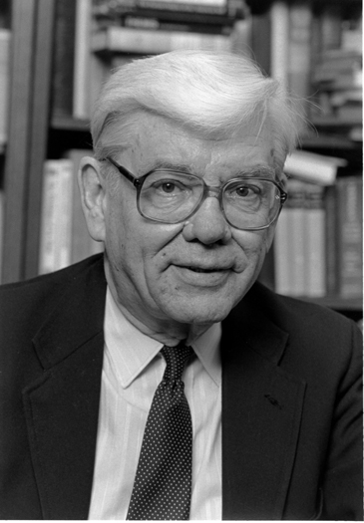
Tradition vs. Traditionalism
Notes:
Jaroslav Jan Pelikan Jr.^{[needs IPA]} (December 17, 1923 – May 13, 2006) was an American scholar of the history of Christianity, Christian theology, and medieval intellectual history at Yale University.

Slide 3
Tradition vs. Traditionalism
Paul told Christians to keep them. 1 Co 11:2
Problems arise when traditions are bound at the expense of God’s express will. Cp. Matt 15:2
Such turns any tradition into the concept of “traditionalism”: it creates a sect within the kingdom.
These are self-imposed “rules” of religion. Col 2:20-23
This was Jesus’ problem with sects. Matt 23:13-15

Slide 4
The gospel + church traditionalism?
Notes:
There are reasons why many in our country refer to it as a “Judeao/Christian” nation.
For centuries many have shared Jesus to fellow Americans.
Over time – due to an ever increasing denominations - our country has become a nation that knows about Christ through the lens of denominations, each crystalizing and becoming distinctive from the others.
So, the modern-day “great commission” looks like us sharing the gospel + our version of what Christianity looks like.
Matt 23:15
“The real Pharisee did not make proselytes from heathenism to Judaism merely, but also from Judaism to Pharisaism.”
“The law can only make proselytes; the gospel alone can convert.”
Lange, J. P., & Schaff, P. (2008). A commentary on the Holy Scriptures: Matthew (p. 411, 412). Logos Bible Software.

Slide 5
What the gospel + man-made traditionalism looks like
Gospel message: We are told to Baptize those who believe Jesus is the Christ and making disciples of them. Matthew 28:19
… + man-made traditionalism (Examples):
Cannot be married if you are called to ministry?
Voting on church membership?

Slide 6
Do we “cross the line” from one to the other?
Tradition
Or
Traditionalism?

Slide 7
Tattoos Jews forbidden because it was tied to paganism Lev 19:28

Slide 8
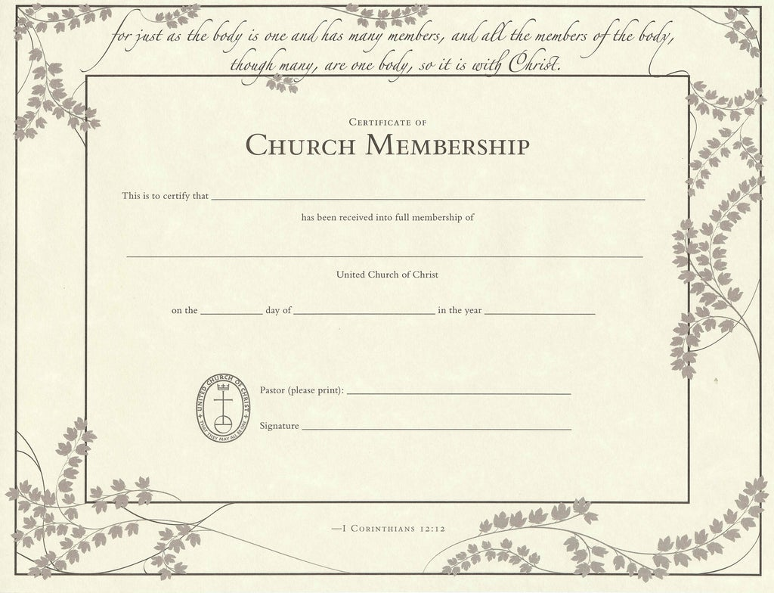
Church membership? Acts 9:26-28

Slide 9
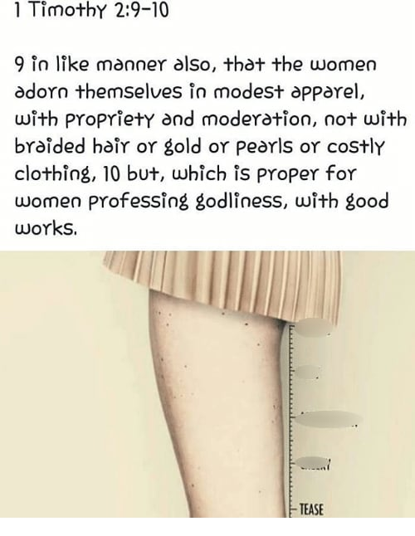
Modesty/ women≠pants:
using OT and NT passages to create a modesty “law”. Exo 28:42; Deut 22:5

Slide 10
Traditionalism = Sectarian/Denominational The Restoration Movement example:
Early 1800s: restore 1st century church/unity
1906 – churches of Christ/Christian Church (Disciples of Christ)
Within churches of Christ:
Institutional/Non-institutional
One cup, no class
No building
No located preacher movement
ICOC: International Churches of Christ (Boston/Crossroads movements)

Slide 11
Be intentional with those we reach
“Speak where the Bible speaks” and be “silent where the Bible is silent.”
Be free to practice traditions, not traditionalism
Make disciples of Jesus, not members of a sect.

