Slide 1
Why it matters to you
Isaiah 9:6-7

Slide 2
The kingdoms of men vs. the kingdom of God
Daniel 7:1-14, 17 Isaiah 11:1-10

Slide 3
“For the love of money is a root of all kinds of evil, for which some have strayed from the faith in their greediness, and pierced themselves through with many sorrows.” 1 Timothy 6:10

Slide 4
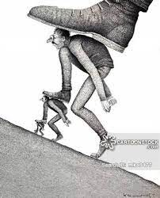
You don’t get anywhere without stepping on some people.

Slide 5
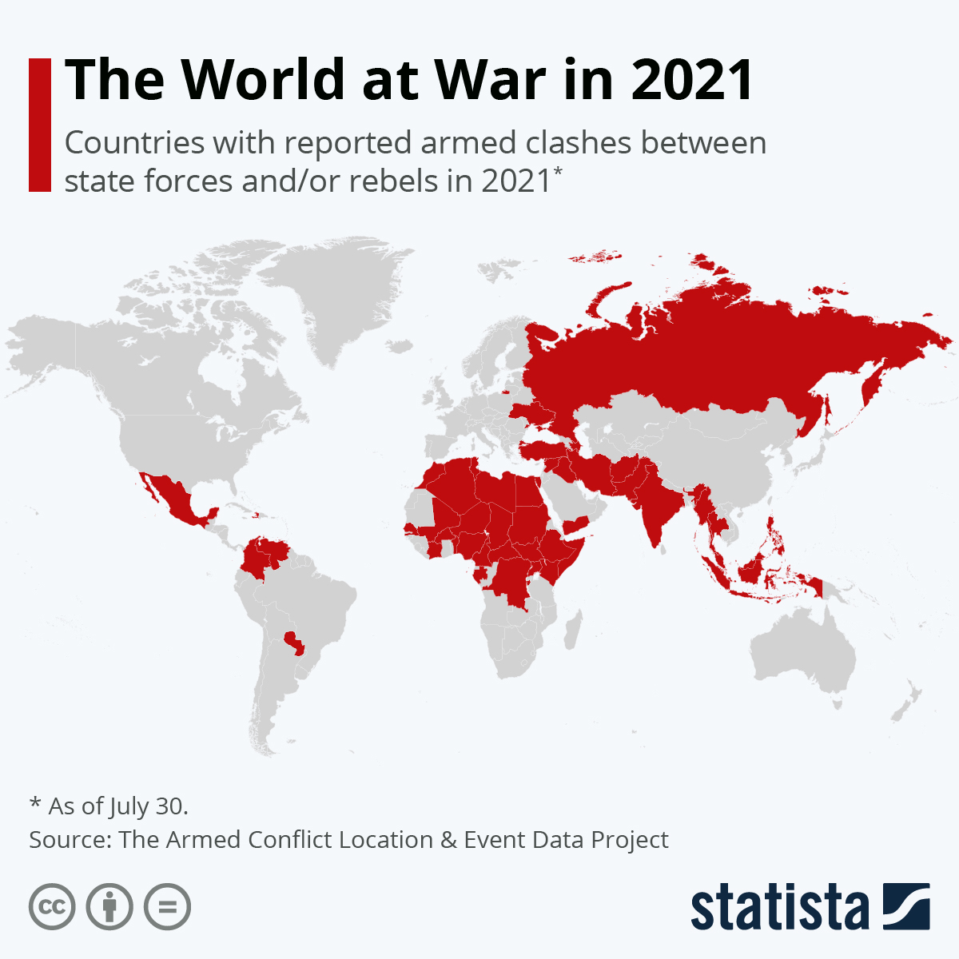

Slide 7
Isaiah 11:3-5

Slide 8
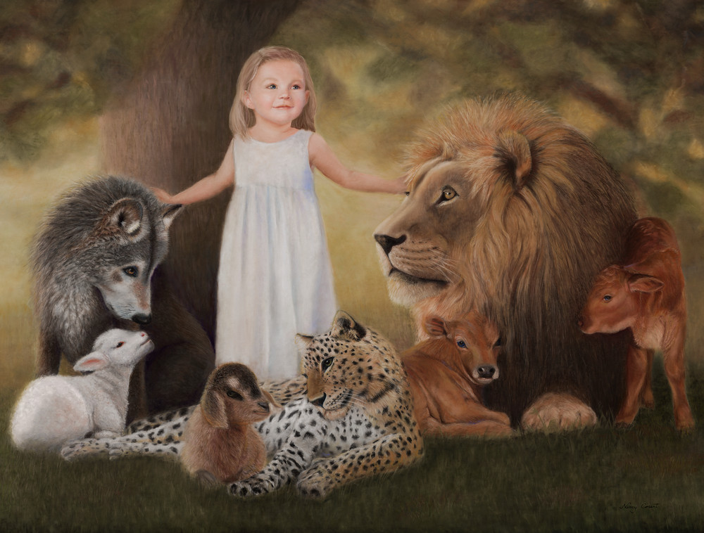
A kingdom of peace
Isaiah 11:6-7
(Romans 15)

Slide 9
Matthew 5:1-10
Matthew 6:9-10

Slide 10
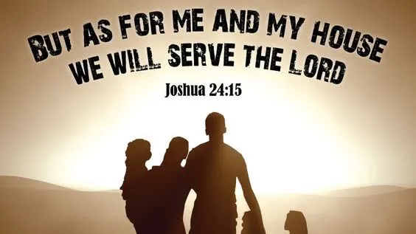
Choose which kingdom you want by how you live

