Slide 1
2022
Things you can do in 2022

Slide 2
Looking back, to grow forward

Slide 3
When you assemble… James 2:2
GREET, GREET, GREET our visitors
Go up TO THEM; introduce yourself; make them feel welcome; Introduce them to others.
INVITE them to sit WITH YOU.
Show them around the building: bathroom, classrooms and/or cry room.
CHECK-IN, LIKE, AND Share our FaceBook page, livestream, events
This is an invite to the world (your family, friends, FB friends) to have them join in via our Live service.
This may be the seed that plants into their heart the need for Jesus!

Slide 4
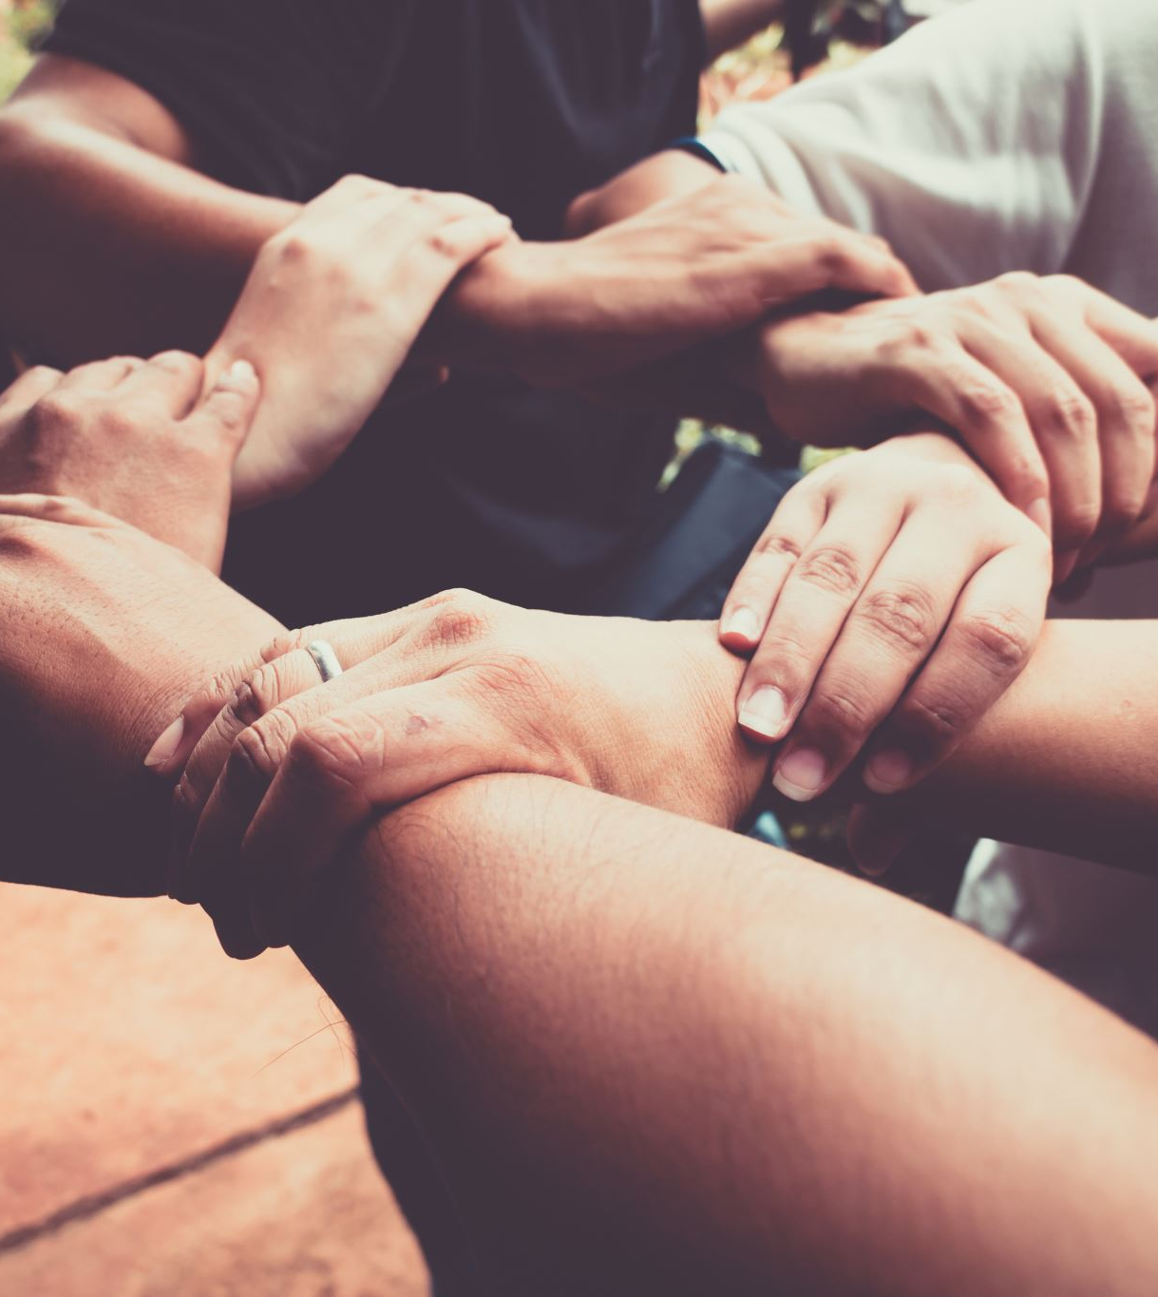
Redeem the time Ephesians 5:16
Retreats: Winter; Spring
Women: Thursday (house to house) studies
Men’s Monthly gatherings: to encourage one another; serve community
Tennessee Prison for Woman (TPW): See Shirley Dark
VBS & Summer Series
Groups: Seniors, Young Adults, Youth, Widows: time together; volunteer to serve others.

Slide 5
House to house Acts 2:46
Share MORE time WITH ONE ANOTHER
Share meals with each other.
While you take care of health considerations... LIVE life that brings edification.
Share one another’s burdens. Gal 6:1-2
Help each other.
Pray with/for one another.

Slide 6
Above all, live as heirs of grace
Titus 3:1-8

