Slide 1
September 6, 2021
Do you know what holiday tomorrow is?

Slide 2
Rosh Hashanah (feast of trumpets) This year (2021): September 6
Did you know?
A number of (messianic) Jews believe that the Lord will return on Rosh Hashanah
This is when the shofar (trumpet) blasts:
99 blasts
100th blast = the last trumpet;– long blast.
This last blast is thought to be the announcement of Jesus’ return. 1 Thess 4:16; 1 Cor 15:50-52

Slide 4
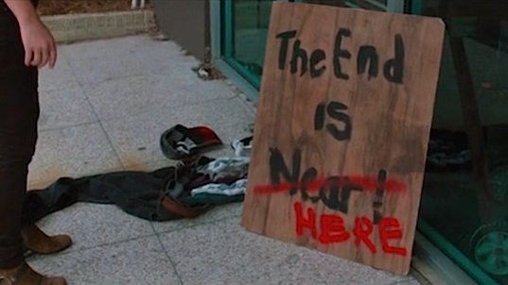
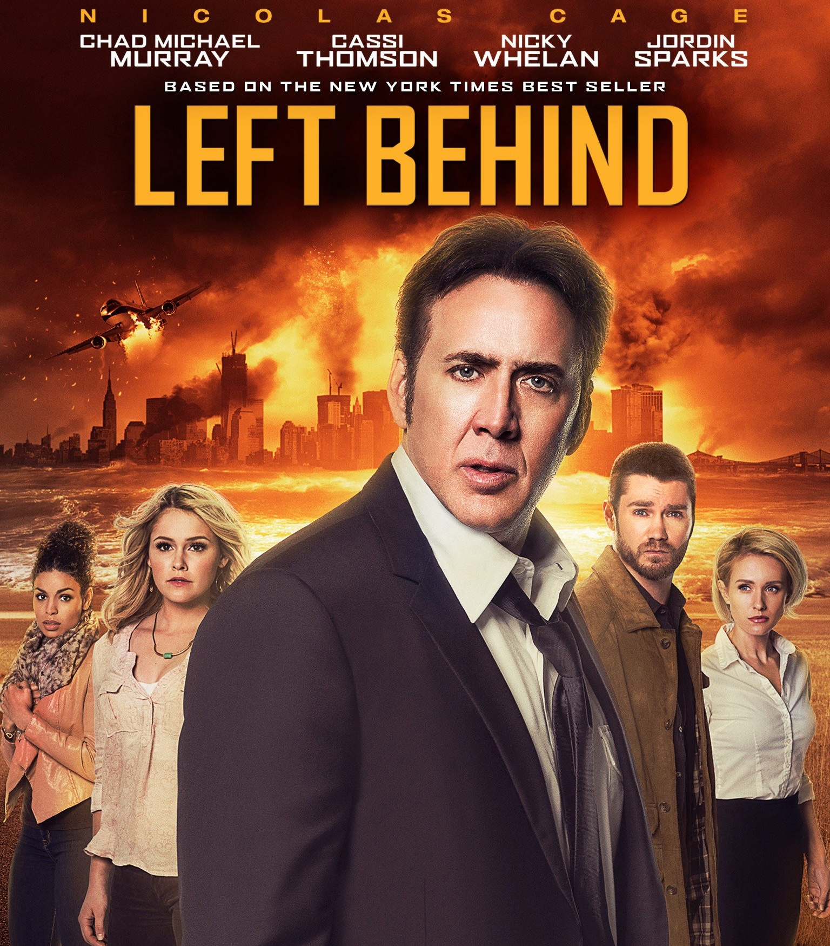

Slide 5
Left Behind?

Slide 6
“the Rapture”
When the Lord returns: 1 Thess 4:13-17
The church will be “caught up” and sent to heaven (somewhere in space/sky).
The “left behind” are non-believers who are left on earth during a 7 year “tribulation”. Matt 24:36-44
Following the tribulation: 1,000 year reign. Rev 20:1-6
Summary of rapture theology:
1st return: secret “rapture”
2nd return: public
Notes:
John Nelson Darby (influenced by the writings of Manuel Lacunza’s “The Coming of the Messiah in Glory and Majesty”) locally popularized “the rapture” in Scotland among the Plymouth Brethren.

Slide 7
The problem with “rapture theology” 1 Thessalonians 4:13-17
Context: what happens to those who have died before the return of Christ? v. 13
Answer: Paul alleviates Christians’ concern. v. 14
The dead in Christ will be resurrected first. v. 16
Those alive will join the resurrected and “meet the Lord in the air”… not go to be with him in the air. v. 17a
Paul says: “we shall always be with the Lord.” v. 17b

Slide 8
The problem with “rapture theology” Matthew 24
Context: Matt 24:1,3
Initially: Destruction of temple. vss. 4ff
Then, things get blurry: is Jesus still talking about the temple or about His return?
Context: whose “left behind”? Matt 24:36-44
Noah: those “taken away” perished while those left behind were saved.
Jesus says the same conclusion upon the “coming of the Son of Man”. vss. 40-42

Slide 9
When the Lord returns
It will be One return: not two.
It will be WITH His “holy ones”. 1 Thess 3:13; 2 Thess 1:7
This will be a time of everlasting judgment. 2 Thess 1:9
We won’t know when it will happen, so be ready. 1 Thess 5:1-2
And When he returns the dead are raised incorruptible: death is swallowed up in victory! 1 Cor 15:54

