Slide 2
Debt
Bullies at school
School Grades
Feeling left out
Stress at work
Sin
Abusive parents
Guilt
Anxiety
Marital Problems
Constant nagging
Rebellious children

Slide 3
Tempted
Conquered kingdoms
Acts of righteousness
Put foreign armies to flight
Sawn in two
Hebrews 11:32-40
Tortured
Stoned
Obtained promises
Escaped the sword
Shut mouths of lions

Slide 4
We’re not the only ones with burdens
Hebrews 11
The cloud of witnesses went through their burdens:
  Abel, Enoch, Noah.
  Abraham, Isaac, Sara, Jacob.
  Moses, Israelites, Rahab.
Believers in our congregation, city,
county, state, country, world.

Slide 5
Hebrews 12:1
Therefore, since we have so great a cloud of witnesses surrounding us, let us also lay aside every encumbrance and the sin which so easily entangles us, and let us run with endurance the race that is set before us.

Slide 6
HEAVY
Life can feel…

Slide 7
While we are encouraged to
“run with endurance”…
God has blessed us with others in His kingdom:
  Who have lived with their own burdens.
  But are in a position to share in our burdens.
They are able to help bear our burdens. Gal 6:2
  He humbly knows his weaknesses.
  V. 3 (1 Co 10:12)
  He knows the difficulty of bearing his own load.
  V. 5
Shared

Slide 8
We further add to our burdens
When we judge one another wrongfully. Matt 7:1-5
When we despise one another. Rom 14:10
When we take advantage of one another. 2 Tim 3:6
When we live this way:
  We degrade the name of Jesus.
  We live contrary to the image of God.
  The church dies.

Slide 9
The questions are…
Are we loving enough? creating an environment of openness. Cp. Jas 5:16
Are we humble enough? to be vulnerable and share our burdens
If we answer yes… and share our burdens…
  The name of Jesus is magnified.
  God is glorified.
  We are edified!

Slide 10
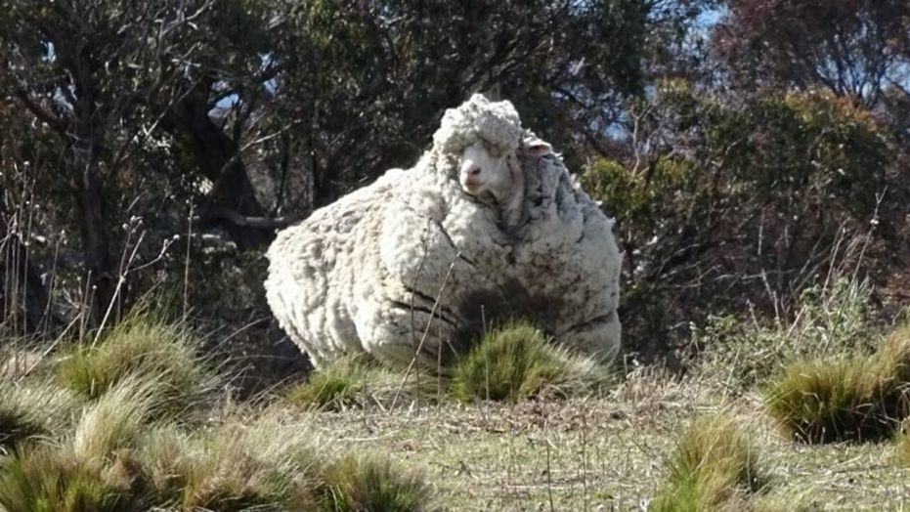
Chris the sheep… 89 lbs. of burdened fleece

Slide 11
Debt free
Overcame bad grades
Faced bullies
Got active
Improved relationships
Righteousness
By faith…
Peace
Love
Defeated Divorce
Gospel sharer
Parents honored

Slide 12
Are you heavy laden?
“Come to Me, all who are weary and heavy-laden, and I will give you rest. “Take My yoke upon you and learn from Me, for I am gentle and humble in heart, and YOU WILL FIND REST FOR YOUR SOULS. “For My yoke is easy and My burden is light.”
Matthew 11:28-30

