Slide 1
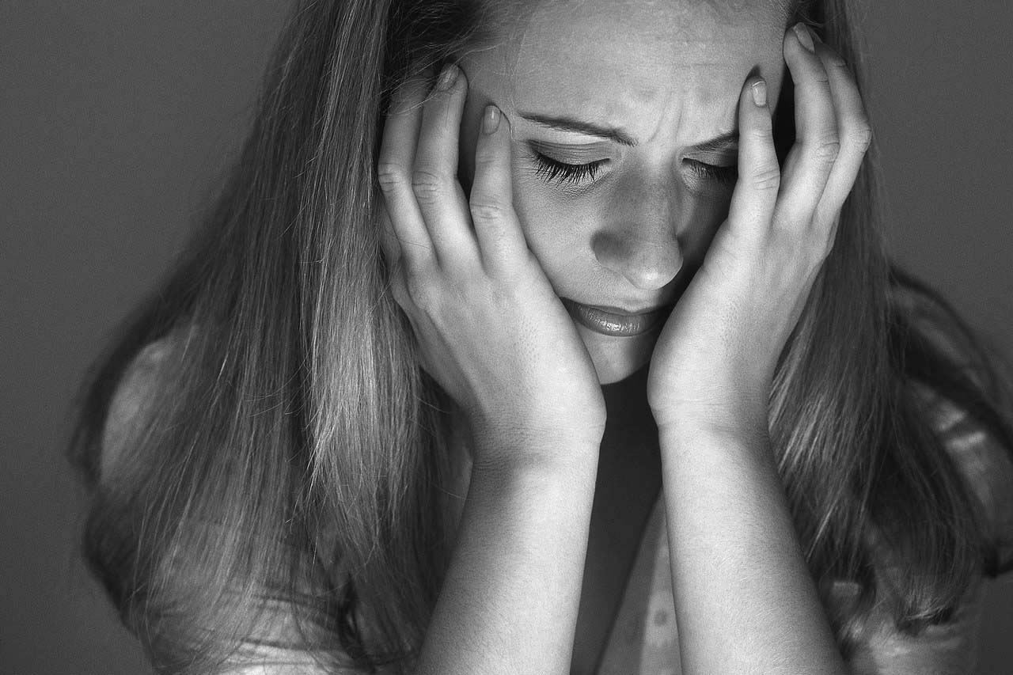
Understanding Depression, Anxiety and Suicide prevention

Slide 2
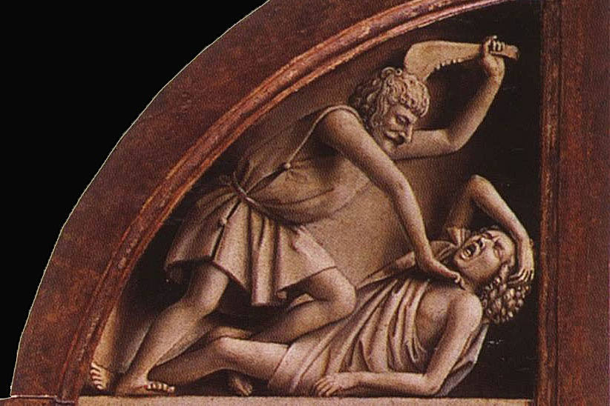
Bible Characters and Depression
Cain (Gen. 4:6-7).

Slide 3
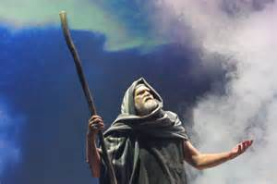
Bible Characters and Depression
Moses (Num. 11:10-16).

Slide 4
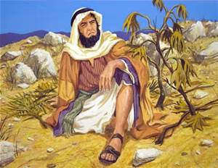
Bible Characters and Depression
Jonah (4:1-11).

Slide 5
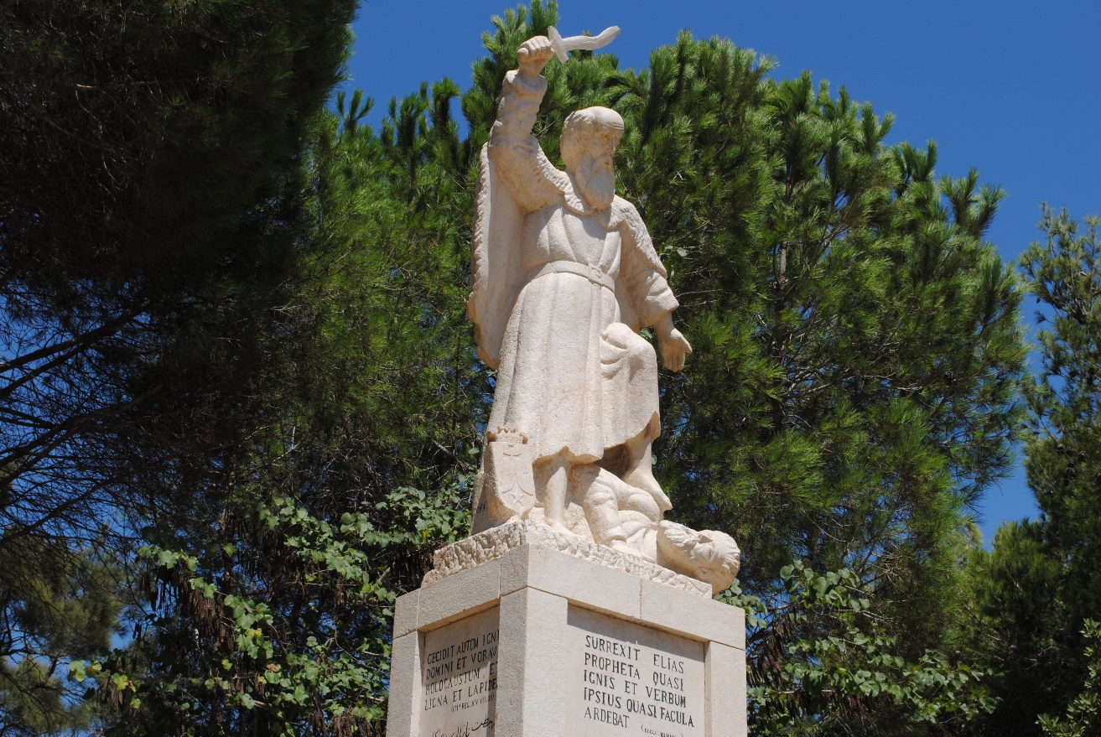
Bible Characters and Depression
Elijah (1 Kings 19:1-18).

Slide 6
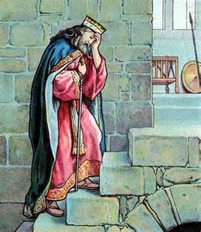
Bible Characters and Depression
David (2 Sam. 12:10ff).

Slide 7
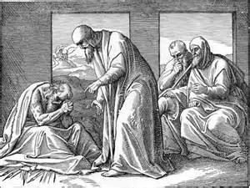
Bible Characters and Depression
Job.

Slide 8
Others
King Saul (1 Sam. 16:14-23)
  Depression? Music helped.
Ahab (1 Kings 21:4).
  Vexed. Laid on his bed. Turned face to wall. Would not eat. Spirit was sullen.
Judas (Matt. 27:3ff).
  Committed suicide.
Peter (Matt. 26:75).
  Preached to others.
Paul (2 Cor. 11:23-29).
  Persecutor. Murderer. Turned sufferer for the cause.

Slide 9
Jesus
Lk. 13:34-35; Matt. 26:38; Mk. 14:33ff; Lk. 22:39-46
Grief over rejection of the grace of God.
In the Garden of Gethsemane.
Scourging and crucifixion.
“Learned obedience from the things He suffered” (Heb. 5:8).

Slide 10
What is Depression?
Sadness is a normal reaction to life’s struggles, setbacks, and disappointments.
Depression is different from normal sadness by:
  Engulfing your day-to-day life,
  Interfering with your ability to work, study, eat, sleep, and have fun.
The feelings of helplessness, hopelessness, and worthlessness are intense and unrelenting, with little, if any, relief.

Slide 11
Common Signs and Symptoms
Feelings of helplessness and hopelessness
Loss of interest in daily activities
Appetite or weight changes
Sleep changes
Anger or irritability
Loss of energy
Self-loathing
Reckless behavior
Concentration problems
Unexplained aches and pains

Slide 12
Changes in behavior and thinking
These may include:
  General slowing down
  Neglect of responsibilities and appearance
  Poor memory
  Inability to concentrate or think clearly
  Suicidal thoughts, feelings, or behaviors
  Difficulty making decisions
  Negative attitude and outlook

Slide 13
Depression in teens
Some appear sad – most appear irritable
Poor performance in school
Withdrawal from friends and activities
Anger/rage
Overreaction to criticism
Suicidal thoughts
Poor self-esteem or guilt
Substance abuse or acting out to avoid feelings

Slide 14
Not All Depression is the Same – 9 Types
Major Depression
Dysthymia
Post Partum Depression
Seasonal Affective Disorder
Atypical Depression
Psychotic Depression
Bi-Polar Depression (Manic/Depressive)
Premenstrual Dysphonic Disorder
Situational Depression

Slide 15
Risk factors
Loneliness
Lack of social support
Recent stressful life experience
Family history
Early childhood trauma/abuse
Substance abuse
Health problems or chronic pain

Slide 16
Strategies…
Challenge negative thoughts
  Write down your worries
  Create an anxiety worry period
  Accept uncertainty
Take care of yourself
  Practice relaxation techniques
  Adopt healthy eating habits
  Exercise regularly
  Get enough sleep

Slide 17
Suicide warning signs
Talking, writing, or joking about suicide or death
Giving away prized possessions
Making final arrangements
Depressive symptoms
Sudden, unexplained recovery from profound depression
Marked feelings of helplessness or hopelessness

Slide 18
Suicide warning signs
Risk-taking behavior
Self-mutilating behavior (sometimes)
A suicide plan
Significant change in behavior
Previous suicide attempts
Significant loss
Chemical (drug or alcohol) abuse

Slide 19
Link between anxiety and depression
Anxiety and depression are believed to stem from the same biological vulnerability
Often go hand in hand
Depression can make anxiety worse (and vice/versa)
Important to recognize both conditions

Slide 20
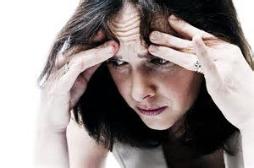
Anxiety
Some anxiety and worry is normal.
These normal amounts of anxiety can actually help you respond to threats and feel motivated to get things done.

Slide 21
Defining Anxiety Types
Separation Anxiety
Selective Mutism
Generalized Anxiety
Social Anxiety
Phobias
Acute Stress Disorders
Obsessive Compulsive Disorder (OCD)
Post Traumatic Stress Disorder ((PTSD)

Slide 22
3 More
Hoarding
Body Dysmorphic Disorder
Trichotillomania (irresistible urges to pull out body hair)

Slide 23
Commandments
Matthew 6: 25
Philippians 4: 6-7
1 Peter 5:7

Slide 24
Matthew 6:25
“For this reason I say to you, do not be worried about your life, as to what you will eat or what you will drink; nor for your body, as to what you will put on. Is not life more than food, and the body more than clothing?”
1 Peter 5:7
“casting all your anxiety on Him, because He cares for you.”

Slide 25
Philippians 4:6-7
Be anxious for nothing, but in everything by prayer and supplication with thanksgiving let your requests be made known to God. 7 And the peace of God, which surpasses all comprehension, will guard your hearts and your minds in Christ Jesus.

Slide 26
Examples:
Passages To Consider
All people worry:
Paul – 2Cor. 1: 8-19, 4: 8-10, 7: 5, 11: 3, 28
Epaphroditus – Phil. 2: 25, 26
Elijah – 1 Kings 19

Slide 27
2 Corinthians 4:8-10
“we are afflicted in every way, but not crushed; perplexed, but not despairing; 9 persecuted, but not forsaken; struck down, but not destroyed; 10 always carrying about in the body the dying of Jesus, so that the life of Jesus also may be manifested in our body.”

Slide 28
2 Corinthians 7:5
“For even when we came into Macedonia our flesh had no rest, but we were afflicted on every side: conflicts without, fears within.”
2 Corinthians 11:28
“Apart from such external things, there is the daily pressure on me of concern for all the churches.”

Slide 29
Epaphroditus
Philippians 2:25-26
“But I thought it necessary to send to you Epaphroditus … 26 because he was longing for you all and was distressed because you had heard that he was sick.”

Slide 30
Anxiety & Distress
“But I have a baptism to undergo, and how distressed I am until it is accomplished!” Luke 12:50 NASB
“You have been distressed by various trials” 1 Peter 1:6 NASB

Slide 31
Passages To Consider
Causes of worry:
Daily difficulties – Numbers 21: 4-5
Family Concerns – 1 Kings 9:5, 10:2
Ungodly living – Psalm 32: 3-4, Hebrews 5: 12-14

Slide 32
Daily Difficulties
Numbers 21:4-5
“and the people became impatient because of the journey. 5 The people spoke against God and Moses, “Why have you brought us up out of Egypt to die in the wilderness? For there is no food and no water, and we loathe this miserable food.”

Slide 33
Family Concerns
Legitimate / Understandable Anxiety
Saul said to his servant who was with him, “Come, and let us return, or else my father will cease to be concerned about the donkeys and will become anxious for us.” 1 Samuel 9:5, NASB
“…your father has ceased to be concerned about the donkeys and is anxious for you, saying, “What shall I do about my son?” ’ 1 Samuel 10:2 NASB

Slide 34
Ungodly Living
Psalm 32:3-4
When I kept silent about my sin, my body wasted away Through my groaning all day long. 4 For day and night Your hand was heavy upon me; My vitality was drained away as with the fever heat of summer.
See Romans 4:6-8

Slide 35
Proverbs 12:25
Anxiety in a man’s heart weighs it down, But a good word makes it glad. NASB
Anxiety in a man’s heart weighs him down, but a good word makes him glad. ESV
Anxiety in a man’s heart weighs it down, but a good word cheers it up. HCSB
Anxiety weighs down the human heart, but a good word cheers it up. NRSV
Anxiety weighs down the heart, but a kind word cheers it up. NIV
de a gah – “restlessness, worry; an attitude or emotion of distress”
DBL - Dictionary of Biblical Languages with Semantic Domains

Slide 36
Psalm 38:18
For I confess my iniquity; I am full of anxiety because of my sin. NASB
So I confess my guilt; I am anxious because of my sin. HCSB
I confess my iniquity; I am troubled by my sin. NIV
I confess my iniquity; I am sorry for my sin. ESV
da ag – “have worry, be troubled”
DBL - Dictionary of Biblical Languages with Semantic Domains
ISBE-R – “worry, care grief, troubled, greatly alarmed”

Slide 37
Symptoms of anxiety
Emotional symptoms of anxiety
Feelings of apprehension or dread
Trouble concentrating
Feeling tense and jumpy
Anticipating the worst
Irritability
Restlessness
Watching for signs of danger
Feeling like your mind’s gone blank

Slide 38
Physical symptoms of anxiety
Pounding heart
Sweating
Stomach upset or dizziness
Frequent urination or diarrhea
Shortness of breath
Tremors and twitches
Muscle tension
Headaches
Fatigue
Insomnia

Slide 39
What is an Anxiety attack?
Surge of overwhelming panic
Feeling of losing control or going crazy
Heart palpitations or chest pain
Feeling like you’re going to pass out
Trouble breathing or choking sensation
Hyperventilation
Hot flashes or chills
Trembling or shaking
Nausea or stomach cramps
Feeling detached or unreal

Slide 40
What causes an anxiety attack?
Playing the ‘what if’ game – negative self talk which sets us up for failure
Poor self esteem – thinking not worthy
Too much pressure to be perfect
Focusing too much on self vs. others
Eating poorly – too much caffeine
Not exercising
Full exposure to phobias
Holding in feelings

Slide 41
Questions to ask yourself?
Do you make time each day for yourself?
Are you getting the emotional support that you need?
Are you taking care of your body?
Are you overloaded with responsibility?
Do you ask for help when you need it?
Do you know how to bring your life into balance?

Slide 42
Professional treatment is often recommended for depression and anxiety.

Slide 43
What NOT to say…
“This will make you stronger”
“Time heals all wounds”
“ I know how you feel”
“It could be worse”
“It will work itself out”

Slide 44
How to help
LISTEN
Show empathy and concern
Offer to call or talk to a parent, counselor, or other trusted adult with them
Encourage them to get ongoing help for their depression
If they are immediately at-risk, call a suicide hotline or 911

Slide 45
Some Suggested Solutions
Pray to God for strength and guidance
Confess any sin/misbehavior causing the anxiety
Do something (else) productive

Slide 46
Some Suggested Solutions
Proper nutrition/hydration – Elijah
Appropriate medications (if indicated)
Give and receive positive feedback, encouragement
Change the “channel”

Slide 47
Changing Channels
Re-focus on the positive things in our lives
Change the “channel” (our “remote control” may be stuck on the bad) to the
  Gratitude channel
  Beauty channel
  Love channel
Escape Tyranny of Unenforceable Rules

Slide 48
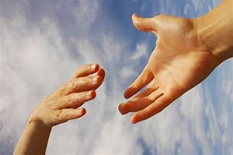
HOPE AND HELP

