Slide 1
20/20 F.A.I.T.H FOR A 2020 VISION
ROMANS 10:17
2 CORINTHIANS 5:7

Slide 2
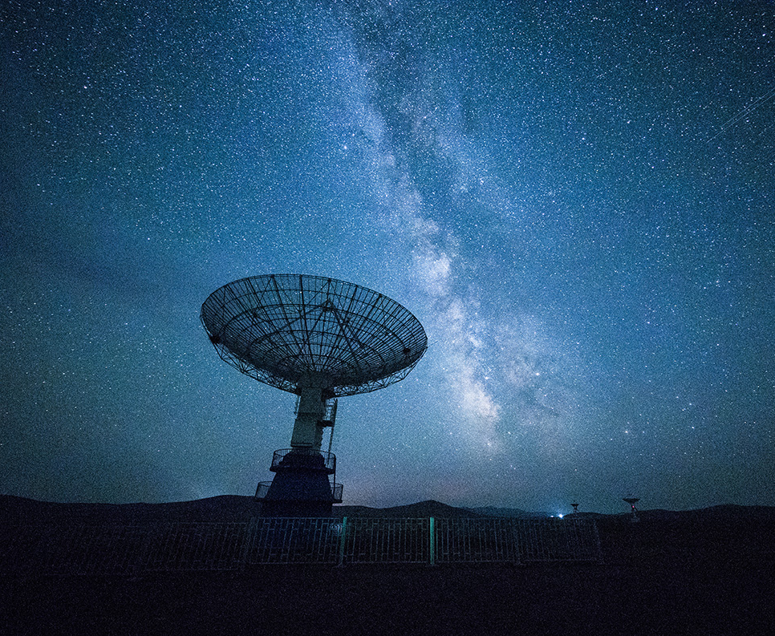
WHAT WE NEED MOST IS FAITH. THESE ARE THE INGREDIENTS OF THAT SUBSTANCE.
Formal
Active
Intentional
Tested
Holy

Slide 3
Where is this biblically?
Hebrews 11:1-3
Ecc. 5:1 & Hosea 6:6
1 Cor 10:31 Rom 12:1
Rom 3:21-22/Col 1:16
1 Peter 6-7/Rom 5:1-5
2 Cor 7:1/ 1 Pet 1:15-16

Slide 4
2 Corinthians 5:6-8 We can do this... together!
Any questions or concerns, contact Zach Ford@
Youngbrotherzach@gmail.com

