Slide 2
What we often think when we hear the word “witness”

Slide 3
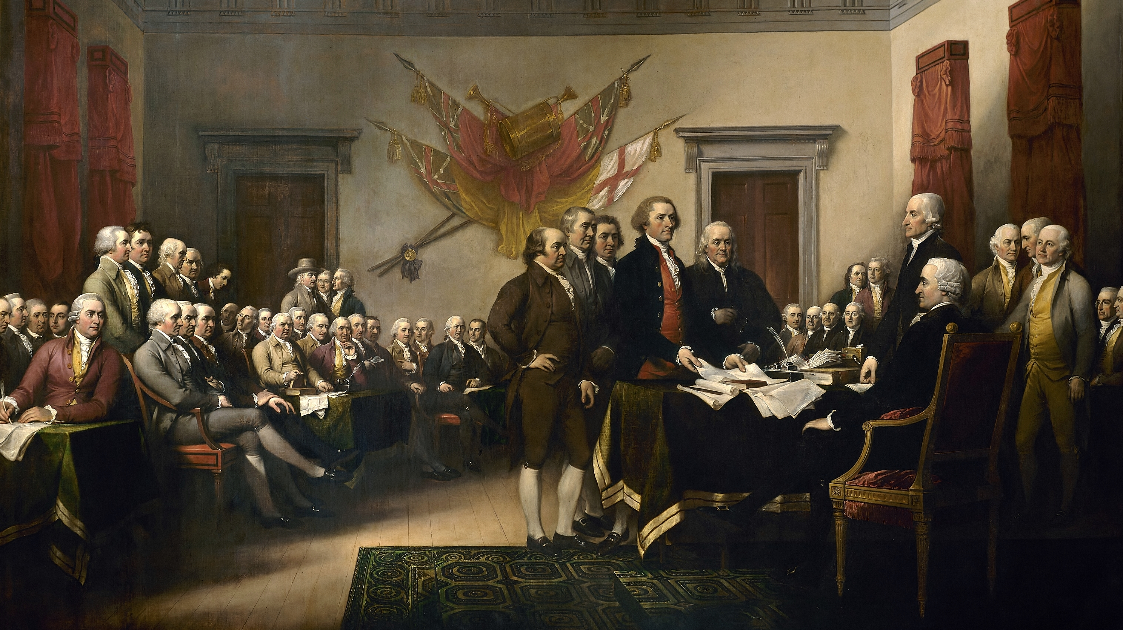
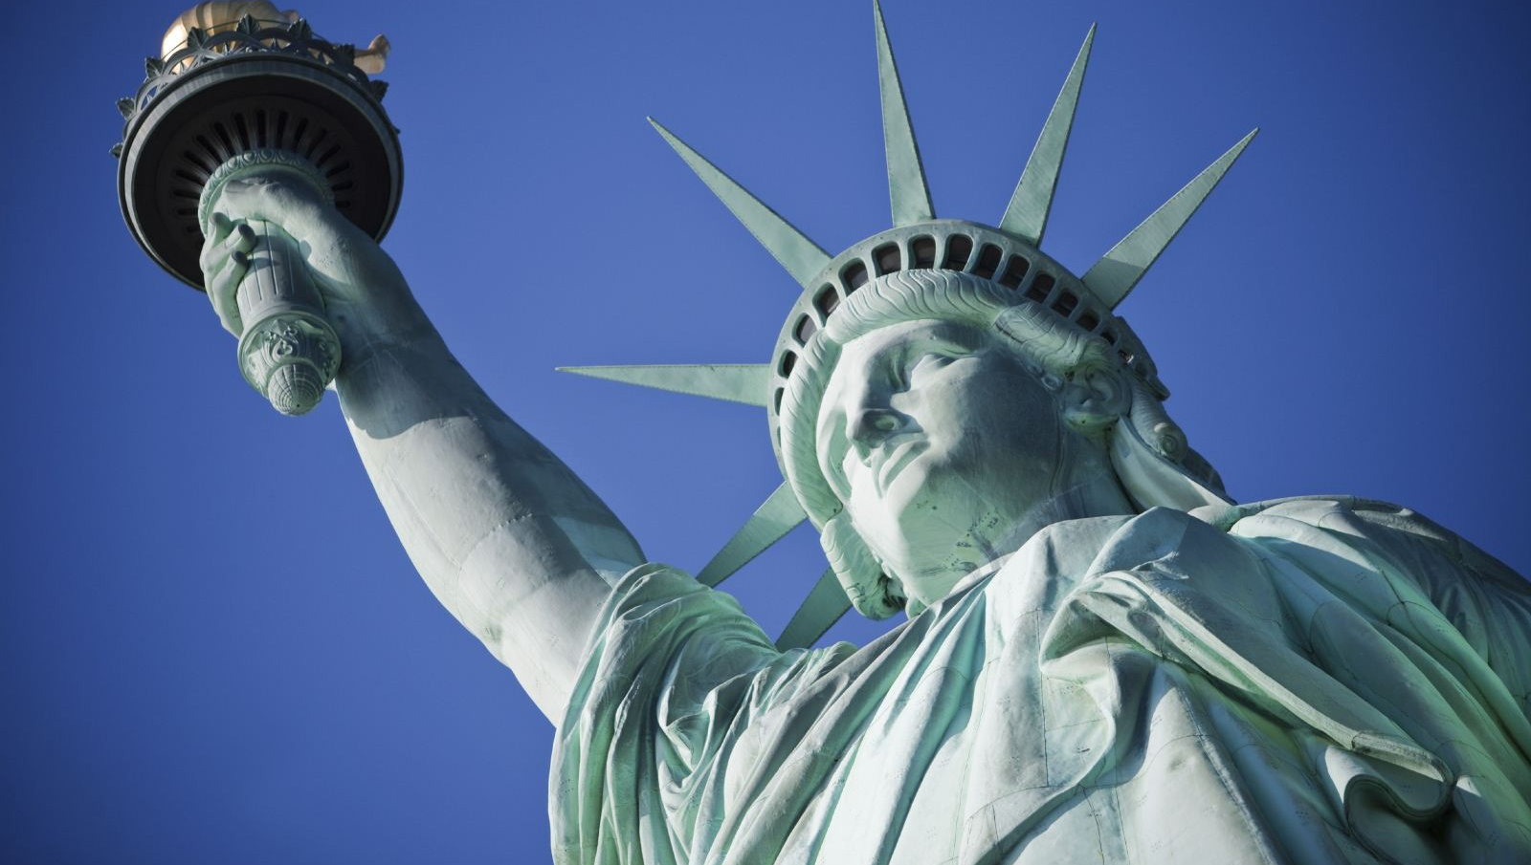
“Give me your tired, your poor, your huddled masses yearning to be free.” Emma Lazarus
Recent History

Slide 4
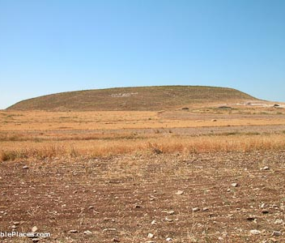
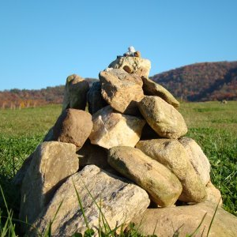
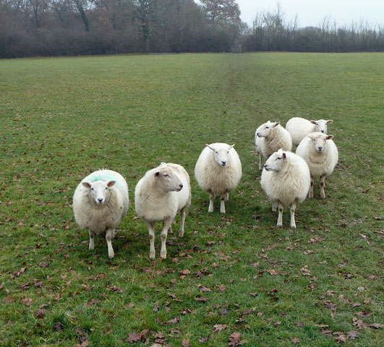
Weird witnesses
Typically tied to a covenant:
Seven ewe lambs: Gen 21:27-30
A pillar: Gen 31:43ff
The Family of the Unsandaled: Deut 25:5-10 (Ruth 4)
Tabernacle of witness: Nu 17:7-8
Ark of the testimony. Exo 25:22

Slide 5
The biblical story of witnessing
God used man to bear witness of His glory:
God’s intent from the beginning. Gen 1:26ff
Through the promise (Gen 12:1ff) God chose Israel to be a nation of priests to witness to the world. Exo 19:4-6; Deut 4:5-6
Because Israel would fail as such (Isa 43:8ff) God would send a true image bearing witness. Lk 7:22-23
And now, followers of Jesus are God’s witnesses to the world. Cp. Eph 3:8-12

Slide 6
Witnessing as Christians today
Our lives are to be living testimonies (or, “witness”): Of the things we’ve received from previous “witnesses”. Cp. Lk 24:48; Acts 1:8, 22, 32
Ultimately our lives, if need be, may be “deprived of life as a result of bearing witness to the things that we believe in the name of Jesus.” Acts 22:20; Rev 17:1-6

Slide 7
“…for the works which the Father has given Me to accomplish—the very works that I do—testify about Me.” John 5:36

