Slide 2
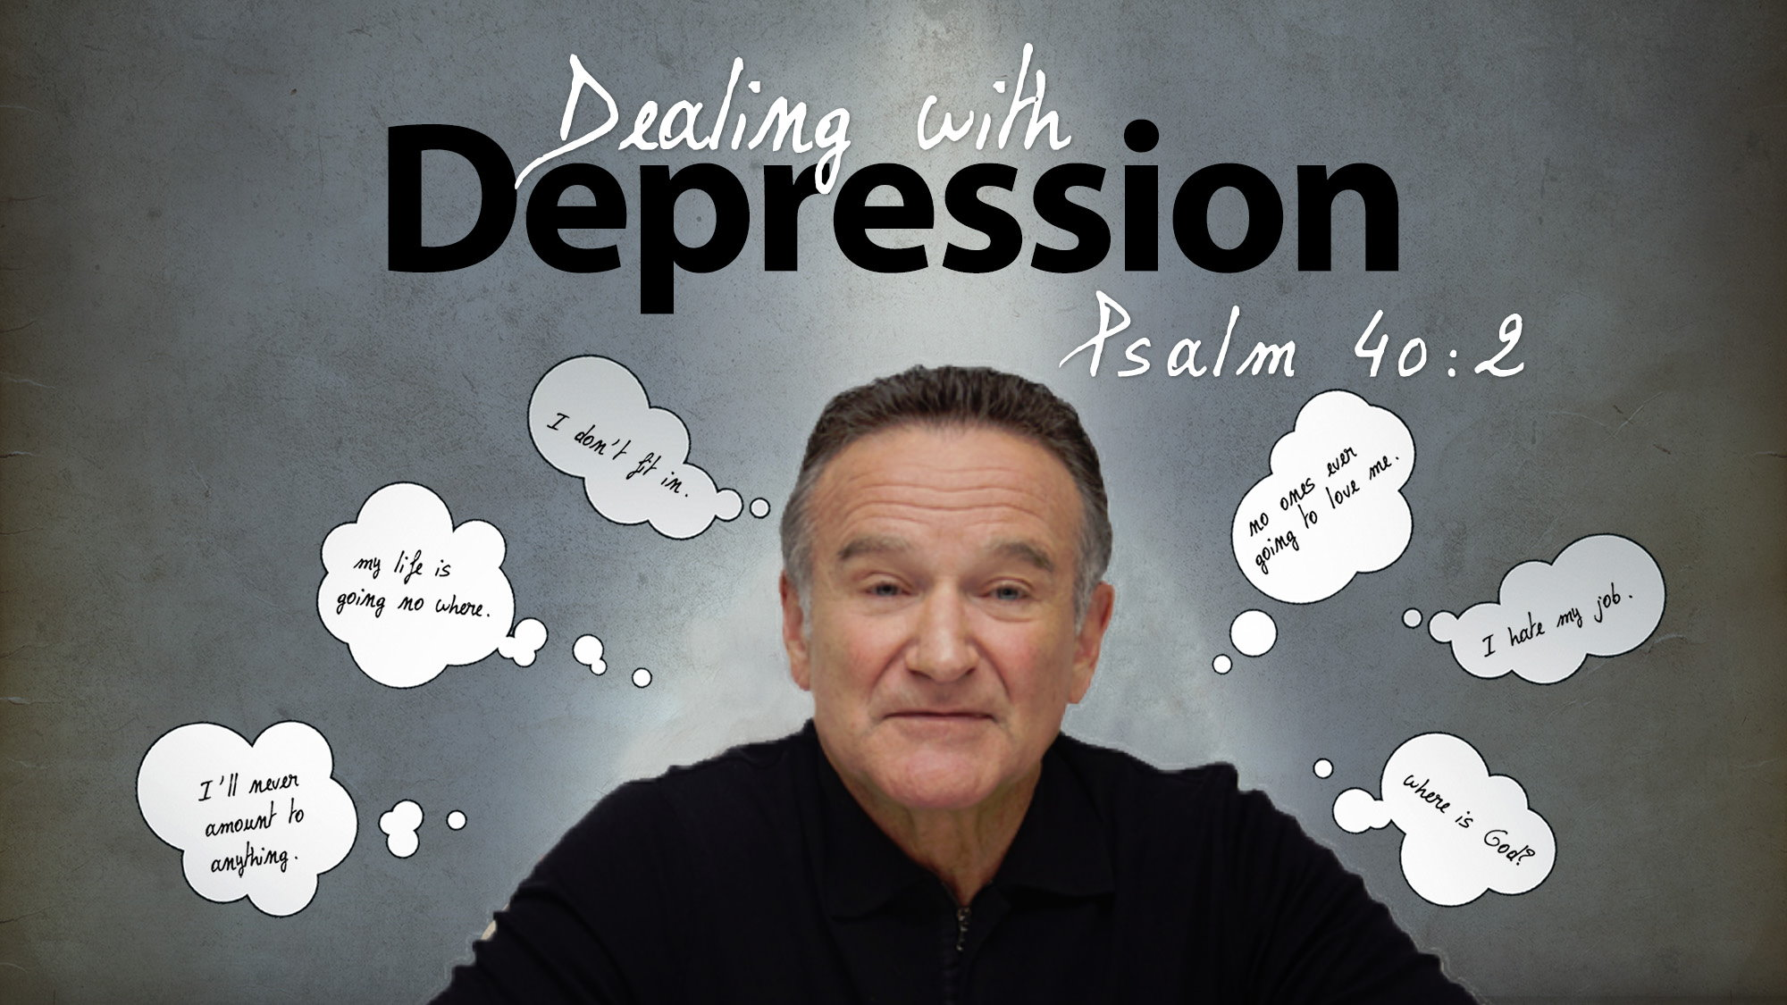

Slide 3
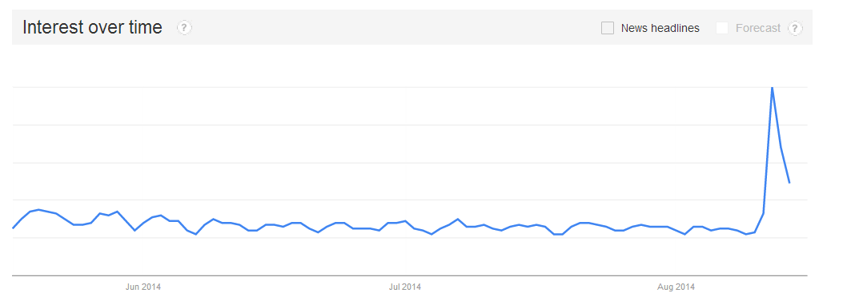
Robin Williams’ suicide brought attention to the subject of depression
Robin Williams Death Inspires 'Coming Out' About Depression (8/14, NBC News)
Robin Williams' death has sparked wider debate
(8/15, BBC)
Since then: Anthony Bourdain, Kate Spade, etc.
Notes:
http://www.bbc.com/news/health-28801558

Slide 4
National Suicide Prevention Week
September 8-14

Slide 5

Jarrid Wilson (…9/9/19)
Battled depression throughout his life
Preached on it often and openly (wrote a book on it).
Founded an organization to help battle depression.
Took his own life

Slide 6


Slide 7
Statistics from Wilson’s research
Over 80% of people who are clinically depressed are not receiving treatment.
The number of people diagnosed with depression increases by 30% every year.
An estimated 121 million people around the world suffer from depression.
In 2013 41,149 suicides were reported, making suicide the 10th leading cause of death for American
In 2013 someone died by suicide every 12.8 minutes.
Notes:
* http://www.mayoclinic.org/diseases-conditions/depression/expert-answers/clinical-depression/faq-20057770

Slide 8
Sidebar questions: suicide
Is suicide another “unpardonable sin”?
Can a Christian still be saved even if they commit suicide?
Are Christians exempt from mental illness because they are in Christ?
Do we legitimize suicide by
referring to it as “mental illness”?
What can Christians do to
help others who struggle
with it?
Notes:
http://www.mayoclinic.org/diseases-conditions/depression/expert-answers/clinical-depression/faq-20057770

Slide 9
Different Historical/Cultural Views
Many sub cultures view it as an unforgiveable sin. Cp. Gen 9:5; Exo 20:13
Jews have two categories of suicide: those in their right mind; and those under duress (“as distressed as Saul”). 1 Sam 31:4
Ancient altruistic (sacrificial)
suicides promoted or
accepted… “seppuku”

Slide 10
Not all clinically depressed, but…
All have experienced some level of depression at some point in their life:
  Job. Job 3:11; Job 17:1
  David. Psa. 6:2-3, 6
  Elijah. 1 Ki. 19:5-10
But, what do we do about it?

Slide 11
Sharing one another’s burdens
Don’t “encourage” like Job’s friends.
  “Just snap out of it.” They would if they could.
  “Pray more”. As if they haven’t
  “Repent”… for having a mental illness?
  “Go and serve others…” They are emotionally paralyzed.
Share their burdens. Gal. 6:1-2
  Be with them. Pray with/for
  them. Serve them.

Slide 12
Working Toward Solutions
Please seek help: professionally and from Christians you can confide in.
Christians want to help but often don’t know how to help…
BEGIN OPEN COMMUNICATION
AMONG BRETHREN

Slide 13
“For I consider that the sufferings of this present time are not worthy to be compared with the glory which shall be revealed in us.”
Romans 8:18

Slide 14
Bring your burdens to Jesus…
“Come to Me, all you who labor and are heavy laden, and I will give you rest. Take My yoke upon you and learn from Me, for I am gentle and lowly in heart, and you will find rest for your souls. For My yoke is easy and My burden is light.””
Matthew 11:28–30

