Slide 2
The Subject of Baptism
Can be as simple as a command: “Repent, and let every one of you be baptized in the name of Jesus Christ for the remission of sins…” Acts 2:38
Or, it can be as subtle, yet so very rich, as an allusion.

Slide 3
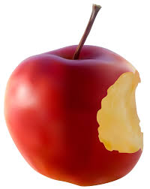
Allusion
al·lu·sion
/əˈlo͞oZHən/
noun
an expression designed to call something to mind without mentioning it explicitly; an indirect or passing reference.

Slide 4
Passage in the Bible?

Slide 5
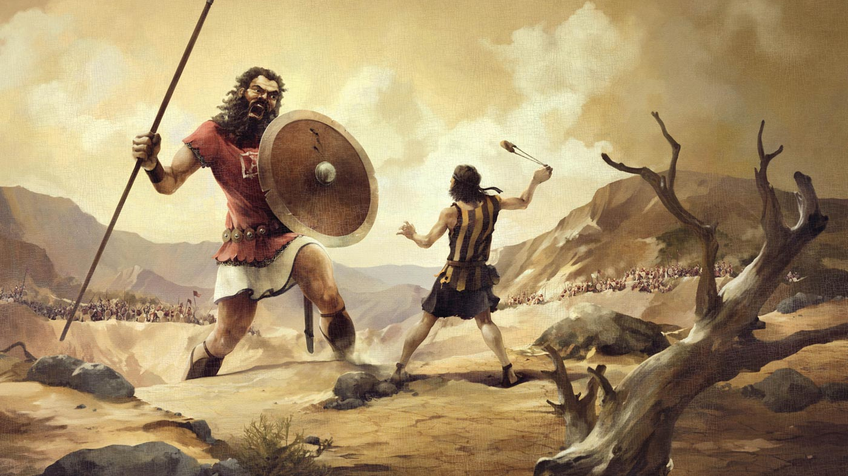
Passage in the Bible?

Slide 6
Passage in the Bible?

Slide 7
Passage in the Bible?

Slide 8
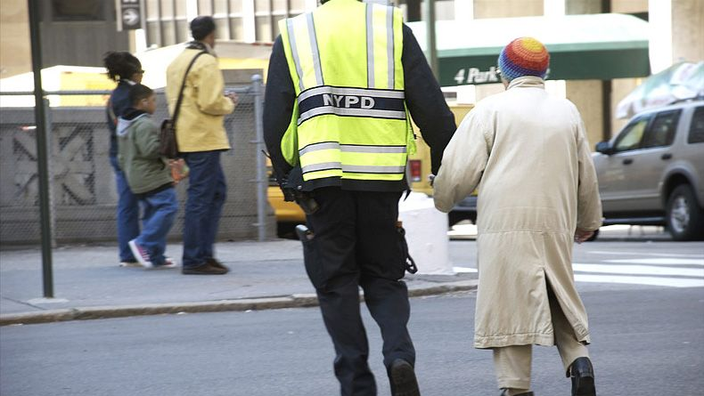
He was a ‘Good Samaritan’
Words, like Images, can allude to people, places, events

Slide 9
The purpose of allusions in the Bible
Biblical authors use allusions for quick comparison to something the reader will refer back to… so as to understand its current usage.
Example: “Lot lifted up his eyes and saw all the valley of the Jordan, that it was well watered everywhere—this was before the Lord destroyed Sodom and Gomorrah—like the garden of the Lord, like the land of Egypt as you go to Zoar.” Gen 13:10

Slide 10
Allusions to Baptism
Creation (a new beginning)
Division (judgment)
Cleansing (sanctification)

Slide 11
Creation (a new beginning)
c
Gen 1:2 Spirit of God present
Matt 3:16; Acts 2:38 Spirit of God present
Jn 3:3-5; 2 Cor 5:17; Rom 6:4

Slide 12
Gen 1:6 Division of the waters
Gen 6; Exo 14
Division in the waters
1 Cor 10:1-2; Tit 3:3-7
Division (judgment)

Slide 13
Cleansing (sanctification)
(Exo 12:2) Exo 19:5-6 kingdom of priests
Exo 29:4, 30:17-21
Cleansed with water to serve
1 Pet 2:4,9; 3:18-21

Slide 14
Baptism Allusions
The NT authors were able – through the Spirit of God – see the allusions of water as it tied to:
The new creation.
Divided judgment: condemnation/salvation.
The need to be cleansed before coming near to God and serving Him.

Slide 15
The result of allusions
Causes us to slow down in our reading/study of God’s word.
Allows God’s word to better marinate in our hearts.
Allows us to go deeper than mere commandments and draw even nearer to our God.

