Slide 1
‘UNEQUALLY YOKED?’ with unbelievers

Slide 2
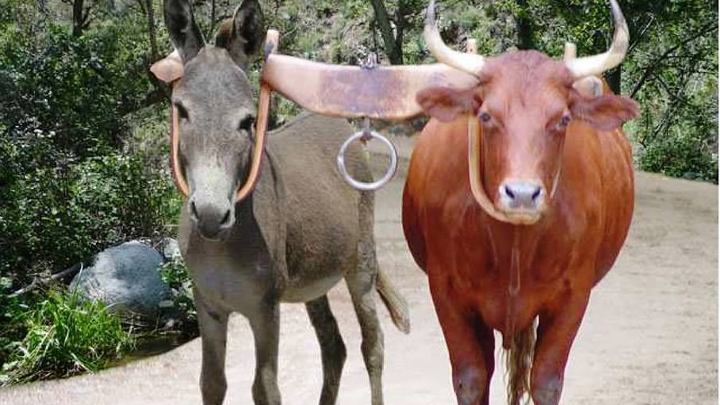
“Do not be UNEQUALLY YOKED with unbelievers” 2 Corinthians 6:14

Slide 3
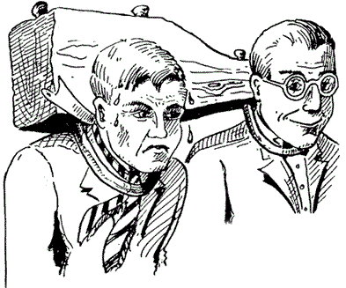
‘UNEQUALLY YOKED?’ What does that even mean?
Sounds like “King James” talk.
Does this mean we should be “equally yoked with unbelievers”?
Does it mean we have nothing to do with people of this world?

Slide 4
2 Corinthians 6:14-16
“Do not be unequally yoked together with unbelievers.
For what fellowship has righteousness with lawlessness?
And what communion has light with darkness?
And what accord has Christ with Belial?
Or what part has a believer with an unbeliever?
And what agreement has the temple of God with idols?
For you are the temple of the living God. As God has said: “I will dwell in them And walk among them. I will be their God, And they shall be My people.”

Slide 5
Similar Laws with a singular purpose Deuteronomy 22 (see Leviticus 19:19)
You shall not sow your vineyard with different kinds of seed, lest the yield of the seed which you have sown and the fruit of your vineyard be defiled. v. 9
You shall not plow with an ox and a donkey together. v. 10
You shall not wear a garment of different sorts, such as wool and linen mixed together. v. 11

Slide 6
The charge: be separate/holy
Believers are invited to be “yoked” to Christ. Matt 11:28-30
Believers whose affections are tied to this world are thus “unequally yoked” to unbelievers. cp. Matt 6:24
These believers are called to be “reconciled” to God. 2 Cor 5:20

