Slide 2
I was poured or sprinkled upon
I was baptized as an infant

Slide 3
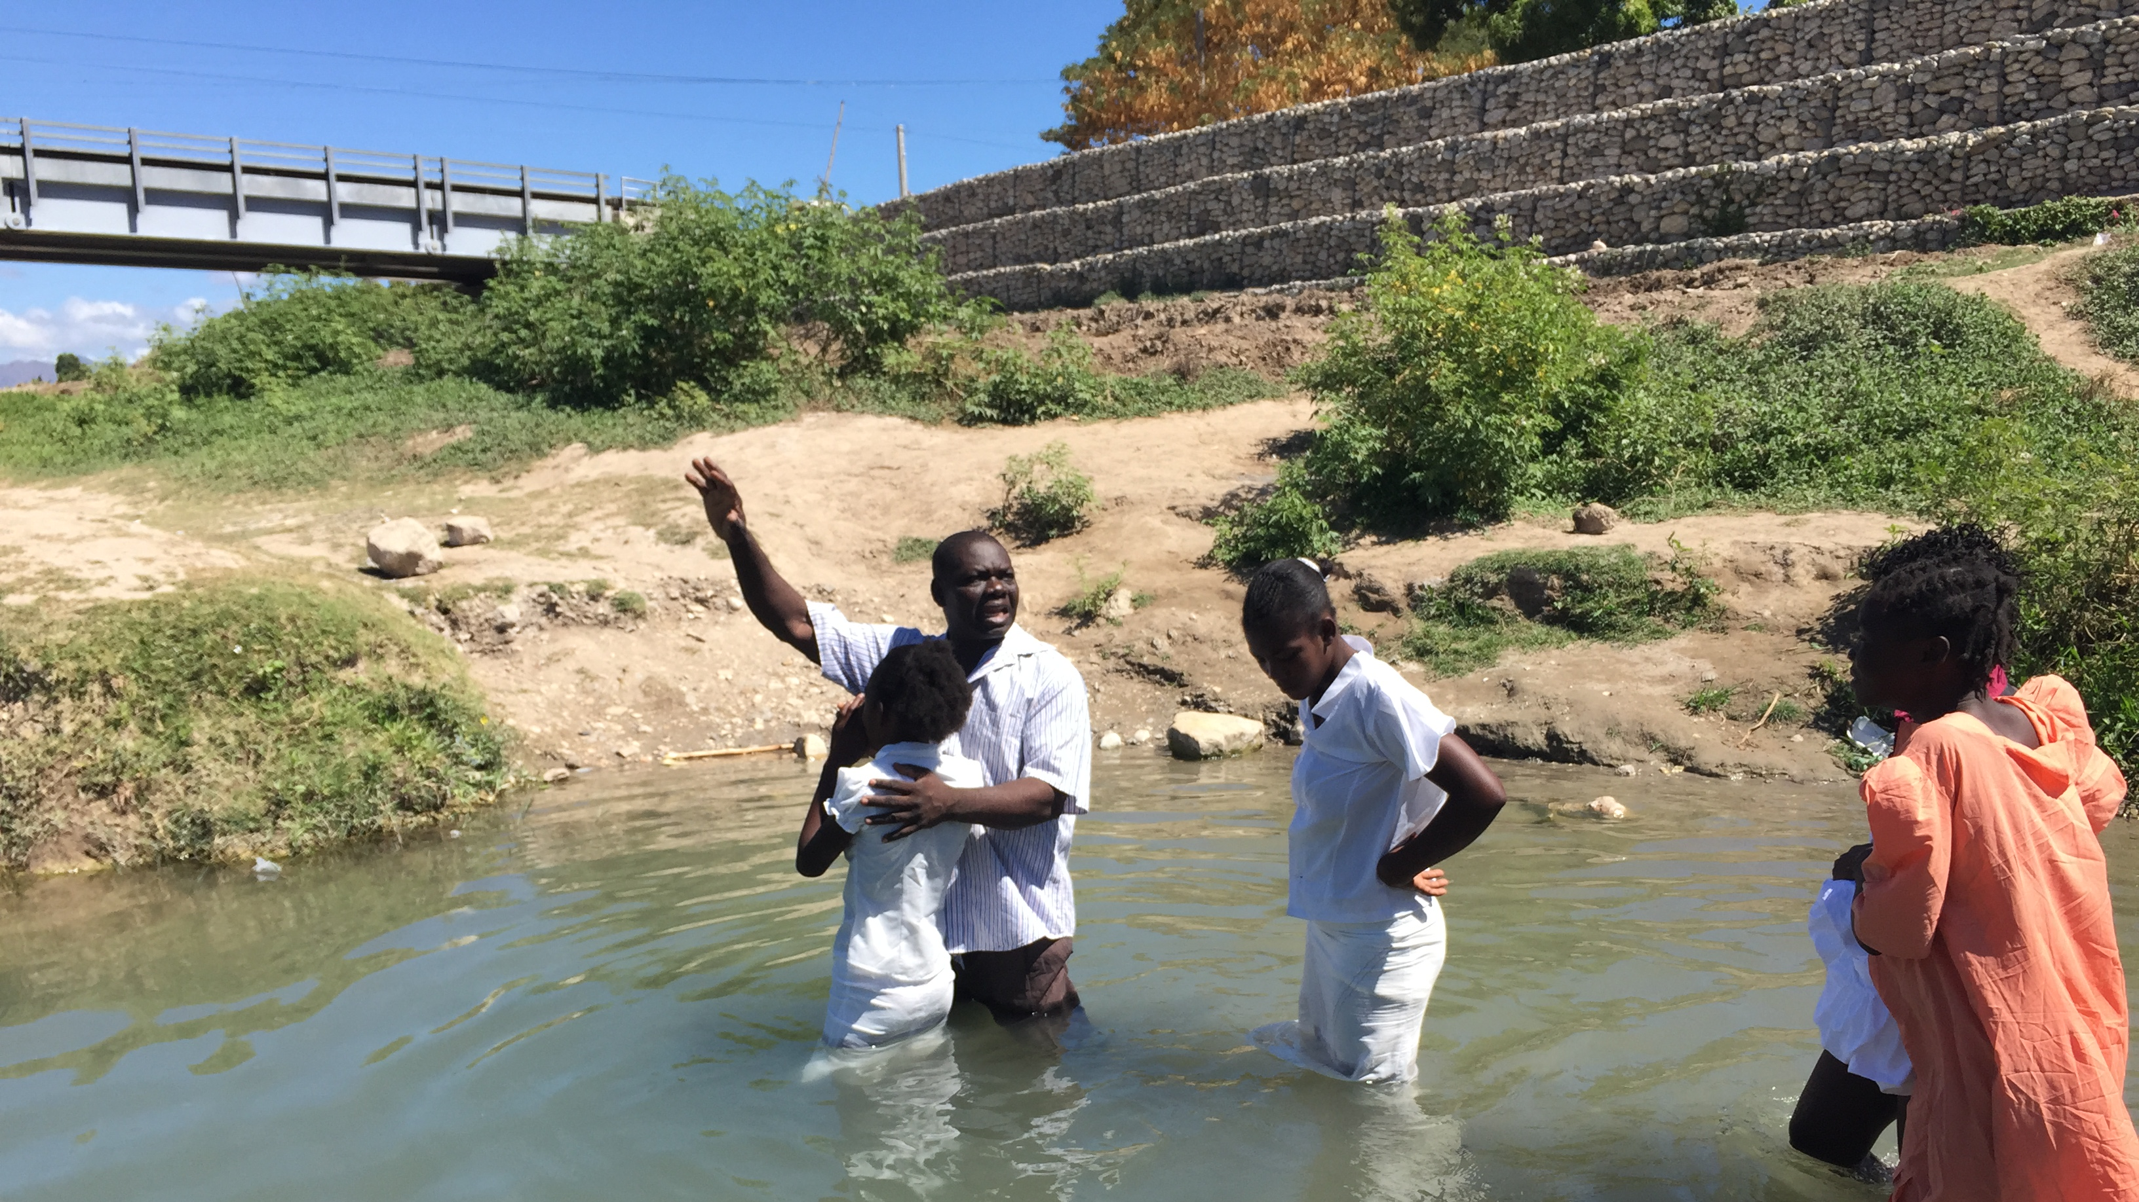
I didn’t know what I was doing

Slide 4
I wanted to appease my parents
my friends did it

Slide 5
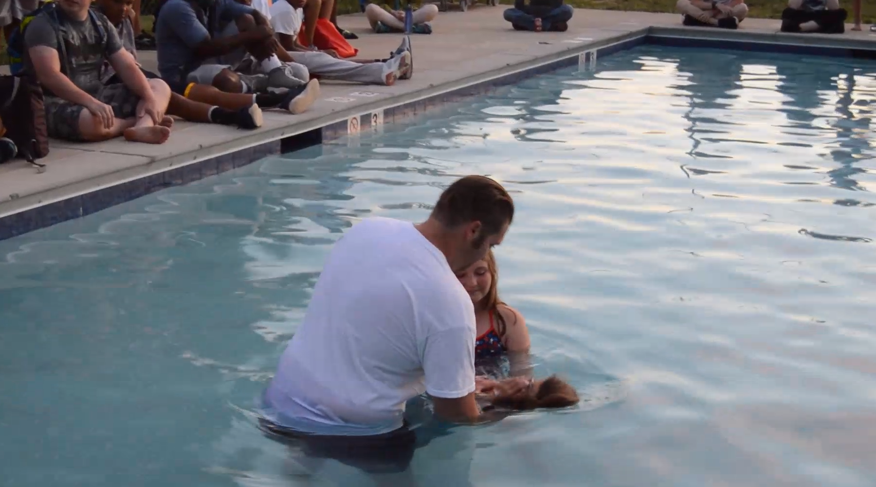
I just REALLY want to do it again
I didn’t truly ‘count the cost’

Slide 6
Is a “2nd Baptism” Needed?
There are many questions or beliefs tied to baptism that have stirred controversy and have lead to asking the need of a 2nd baptism.

Slide 7
Caveat
There is only one passage in the Bible that deals with being baptized a 2nd time. Acts 19:1-5
This was a narrative: not a codified law to the church.
The apostle was curious why disciples did not receive the “Holy Spirit” when they believed in Jesus.
Since no biblical teaching was done to address “2nd baptism” questions we follow biblical principles about baptism itself.

Slide 8
“In the name of…”
Because we are baptized “into Christ” we biblically baptized in the name of Jesus Christ. Acts 2:38
We also baptize in the name of the “Father, Son, and Holy Spirit/Ghost”. Matt. 28:19

Slide 9
“Buried with Christ”
Because baptism is ALWAYS an “immersion” in the Bible, we teach and practice the same. Rom. 6:4 (Acts 8:36-39)
This practice is what illustrates the “death, burial, and resurrection” of our baptism with Jesus’ death, burial and resurrection.

Slide 10
“For the forgiveness of sins”
It is not just a command but a reason tied to baptism. Lk. 24:46-47; Acts 2:38
The illustration tied to forgiveness through baptism is the putting to death the man of sin and that your new resurrected life is found to be walking in harmony with your Savior.

Slide 11
“If you believe… you may”
Biblically, only people who believed were baptized. Mk. 16:16; Acts 8:37
That’s why you’ll never read of an infant being baptized in the Bible.

Slide 12
Why you should or shouldn’t be baptized a second time

Slide 13
To baptize again?... or not THAT is the question
If you’ve mirrored the teaching found in scripture there is no need.
Yet, if your conscience bothers you, there is no wrong or harm in being baptized a 2nd time.

