Slide 2
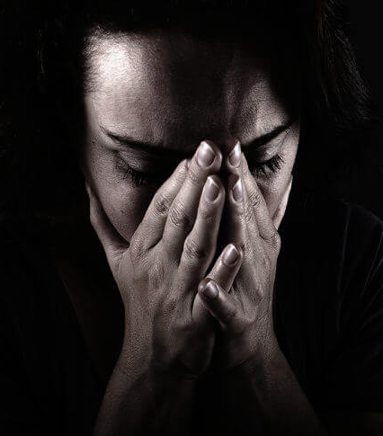
We all grieve at some point
Ecclesiastes 3

Slide 3
Jesus grieved on multiple occasions
He grieved the loss of Lazarus and the pain of Mary’s mourning. Jn 11:30-36
He grieved impending destruction of Jerusalem.
Lk 19:41-44
He admitted to his soul being deeply grieved.
Matt 26:36-38

Slide 4
It’s not that you grieve, but how
But we do not want you to be uninformed, brethren, about those who are asleep, so that you will not grieve as do the rest who have no hope. For if we believe that Jesus died and rose again, even so God will bring with Him those who have fallen asleep in Jesus…. Therefore comfort one another with these words.
1 Thessalonians 4:13–14, 18

Slide 5
Why this is so important for us today
Christians aren’t necessarily the happiest in this world. Cp. Heb 12:32ff
Christians can/should live through pain with hope for our future resurrected lives. 1 Th 4:14
This allows us to grieve… and to “grieve well”.

