Slide 1
LIVING IN BALANCE
Determining Family Priorities
Art Adams, MSW, LCSW, LCAC, CADACIV

Slide 2
IRRECONCILABLE DIFFERENCES
Leading trend for divorce.
DON’T BUY THIS LIE!
Your marriage is not hopeless.
Just as God breathed life into a man, He can breathe life into your marriage if you let Him.
It is time to stop fighting IN your marriage and start fighting FOR your marriage.

Slide 3
IT TAKES AT LEAST TWO TO FIGHT AND IT WILL TAKE THE SAME NUMBER TO MAKE-UP

Slide 4
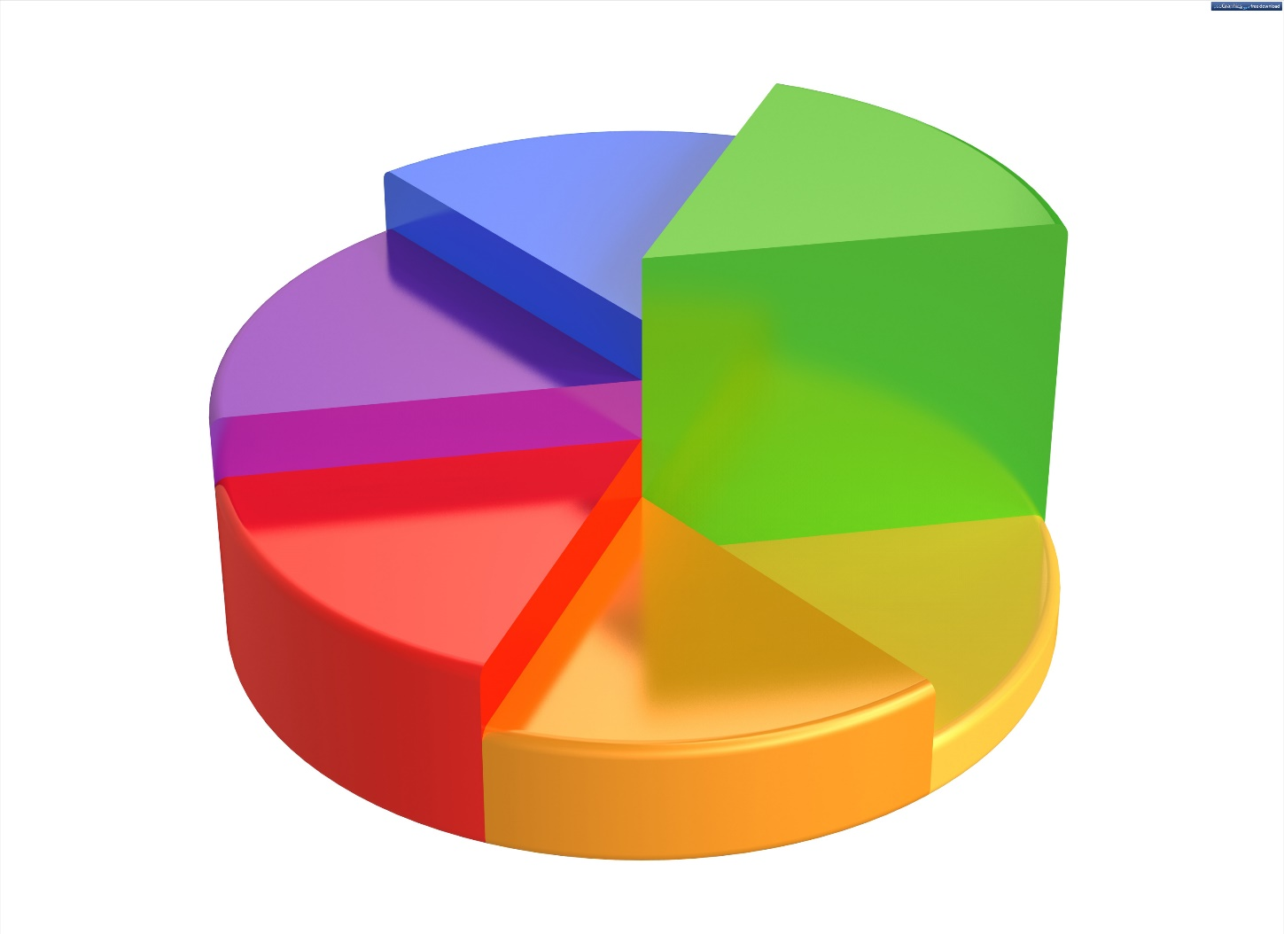
MANY LESSONS ON BALANCE WILL PROVIDE A PIE CHART
SPIRITUAL
SOCIAL
WORK/SCHOOL
PHYSICAL
BIOLOGICAL

Slide 5
It is important to decide what the priorities are in our personal and family life.
It is easy to get lopsided in life and give too much attention to one or two functions and miss LIVING.

Slide 6
“The great tragedy in life is to come to its end only to realize you never lived.”
Henry David Thoreau

Slide 7
The Bible tells us our life is like a vapor that appears for a short time and fades. (James 4: 14)
Consider the rich fool , who put his focus on things that fade. (Luke 12: 13-21)
This lesson goes beyond a pie chart and deals with putting quality into each day. Enough quality days will equal a quality life.
So, how do we put quality into living and especially into our family time?

Slide 8
PRINCIPLES TO LIVE BY FOR A QUALITY LIFE AND SUCCESSFUL HOME
Turn to Ephesians – not chapter 5, but chapter 4
Ephesian 4: 25 – 5:2)

Slide 9
PRINCIPLES TO LIVE BY FOR A QUALITY LIFE AND SUCCESSFUL HOME
A. BE TRUTHFUL ( v. 25)
1. Who lies?
91% of Americans lie routinely about matters they consider trivial
1 out of 3 lie about important matters
86% lie on a regular basis to their parents
75% lie to their friends
7 out of 10 people lie to their spouses

Slide 10
PRINCIPLES TO LIVE BY FOR A QUALITY LIFE AND SUCCESSFUL HOME
2. LYING EFFECTS RELATIONSHIPS
a. Disrupts unity
b. Creates conflict
c. Annihilates trust
d. Destroys relationships
e. Shows Christ is NOT in the communication (I AM the TRUTH) (Satan is a liar and the father of lies)

Slide 11
PRINCIPLES TO LIVE BY FOR A QUALITY LIFE AND SUCCESSFUL HOME
B. YOU CANNOT BUILD A RELATIONSHIP IF HONESTY, INTEGRITY, AND TRUTH ARE NOT VALUED.
1. You can never have a marriage of oneness if you and your spouse fail to value authenticity.
a. If you cannot be real, you are living a lie (sneaking around at ANY level betrays truth and trust).
b. A life of unity cannot be lived with someone who is two-faced.

Slide 12
PRINCIPLES TO LIVE BY FOR A QUALITY LIFE AND SUCCESSFUL HOME
2. Get mad, but don’t sin (v. 26)
a. Do not bottle up your anger (health problems, stress).
b. Learn not to explode in your anger (much damage is done by a loose tongue).
c. Resolve your issues quickly (don’t go to bed angry).

Slide 13
PRINCIPLES TO LIVE BY FOR A QUALITY LIFE AND SUCCESSFUL HOME
3. Play nice (v. 29)
a. Watch the words that come from your mouth.
b. Do they benefit the one listening?
c. Words can heal or hurt – build up or tear down.
d. Be careful using words like Never or Always.

Slide 14
PRINCIPLES TO LIVE BY FOR A QUALITY LIFE AND SUCCESSFUL HOME
4. Defining Your Spouse
a. Define in the positive
b. See your spouse the way God does
c. Edify your spouse
d. Pray for your spouse.
e. Consider each other (Hebrews 10: 24)
f. What does it take to please him/her (1 Cor. 7:33-34)

Slide 15
PRINCIPLES TO LIVE BY FOR A QUALITY LIFE AND SUCCESSFUL HOME
C. ASSURE THAT CHRIST IS IN THE CENTER OF YOUR MARRIAGE
1. Master forgiveness (v. 32) – let past hurts go – build on a foundation of forgiveness

Slide 16
PRINCIPLES TO LIVE BY FOR A QUALITY LIFE AND SUCCESSFUL HOME
2. Love as Christ loved (5: 1-2)
a. Christ’s love meant He confronted in truth.
b. Christ’s love meant He became angry, but He did not sin.
c. Christ loved, therefore everything that came out of His mouth benefited those who would receive what He said.
d. Christ loved, therefore He led a life of worship.
e. Christ loved, therefore He forgave.

Slide 17
DEVELOP A FAMILY MISSION STATEMENT
Our home exists for the purpose of _____________
Our home is a place where Christ is honored and talk of/with Him is welcome
Our home exists to create a safe spiritual atmosphere
Our home is a place where the Bible is modeled during both good and tough times
Our home has rules which are respected
Our home ………

Slide 18
CONCLUSION
If Christ is loved and honored by all, we will not have to worry about “irreconcilable differences.”

