Slide 2
Traditionally Christian—with Exceptions “To get at a sense of enduring faithfulness among Christians despite a rejection of the institutional church, Barna created a metric to capture those who most neatly fit this description. It includes those who self-identify as Christian and who strongly agree that their religious faith is very important in their life, but are “dechurched”—that is, they have attended church in the past, but haven’t done so in the last six months (or more). These individuals have a sincere faith (89% have made a personal commitment to Jesus Christ that is still important to their life today), but are notably absent from church.”
Meet Those Who “Love Jesus but Not the Church” Research Releases in Faith & Christianity • March 30, 2017

Slide 5
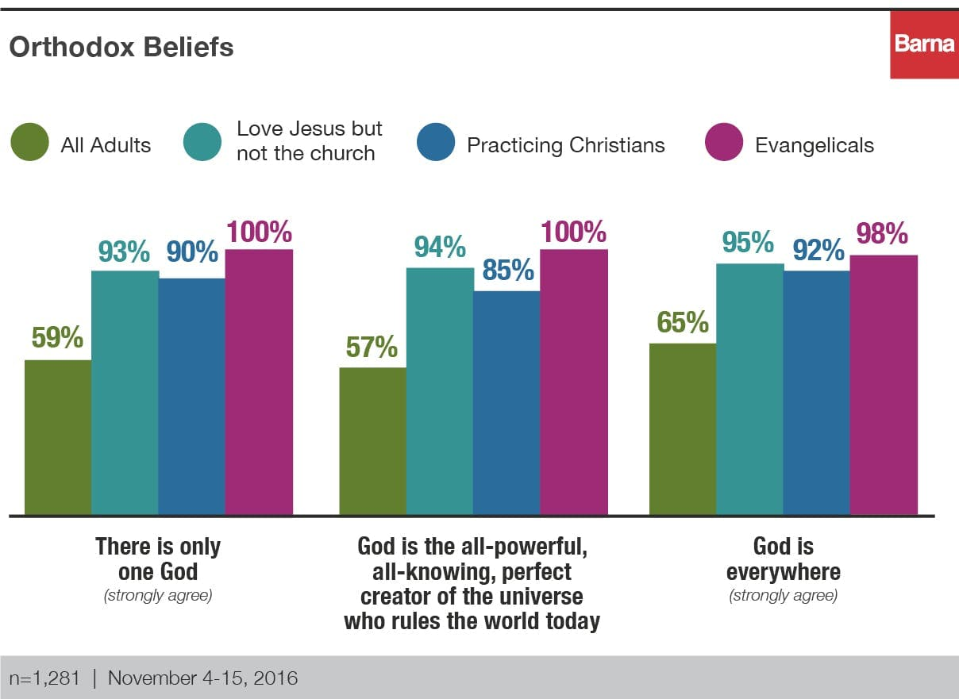

Slide 8
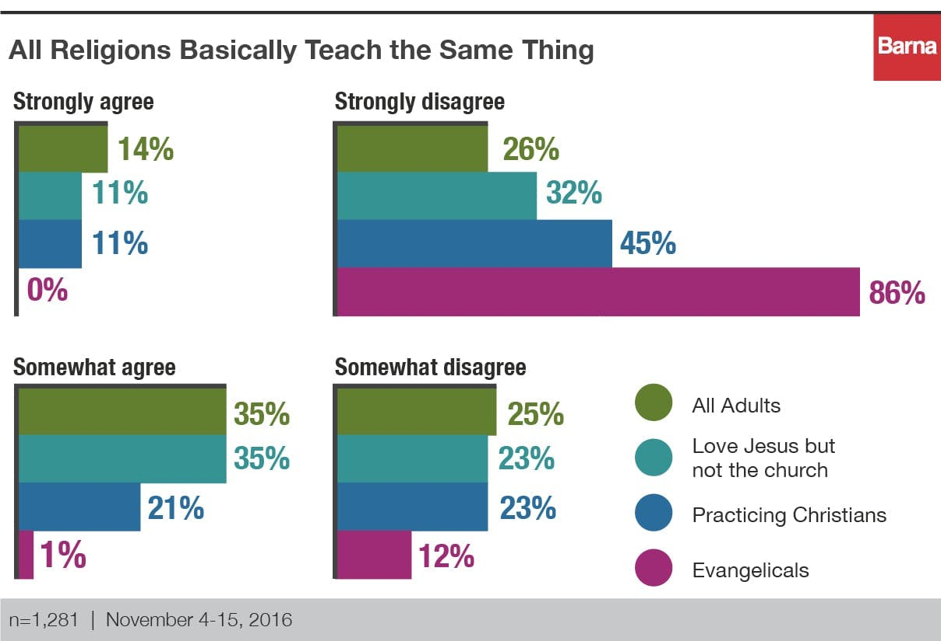

Slide 10
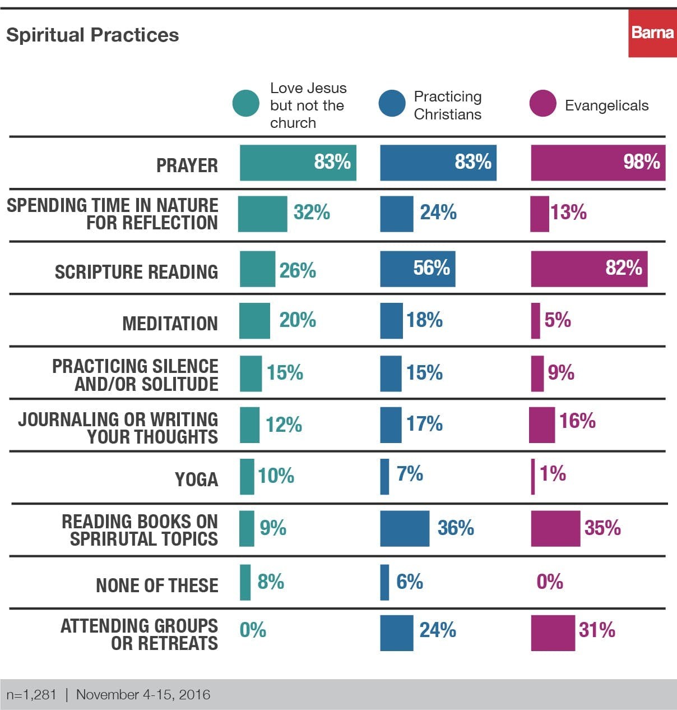

Slide 12
A closer look at these people
Many who have been affected by “the church”
Burned.
Neglected.
Wrongfully Judged.

