Slide 2
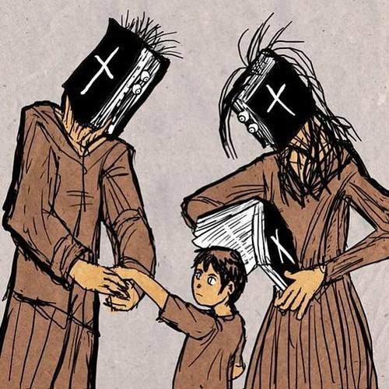
The Somewhat Negative Word
“Religion” = negative perception
“Rules based”.
Tied to fanatical teachings.
Tied to fanatical behavior.

Slide 3
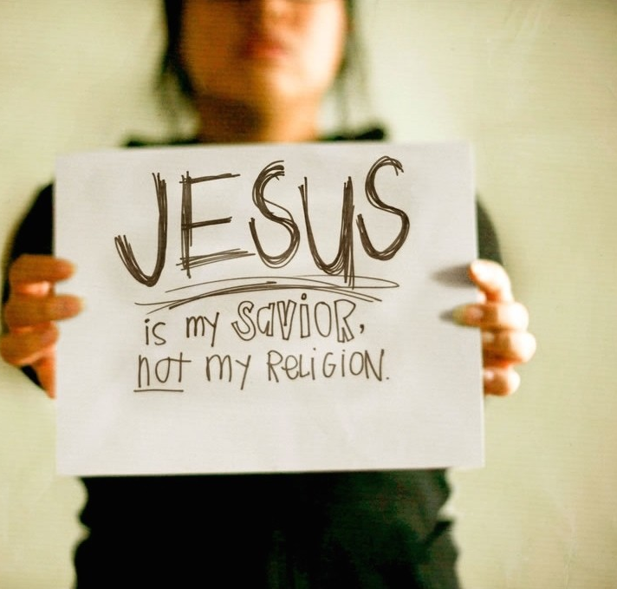
“Spiritual but not religious” people that are turned off with organized “religion”.

Slide 4
The biblically beautiful word
If we are Jesus followers – our set of beliefs will manifest itself through our actions that will:
look like Jesus… Talk like Jesus… Act like Jesus.
“For those whom He foreknew, He also predestined to become conformed to the image of His Son, so that He would be the firstborn among many brethren;” (Romans 8:29).

Slide 5
New Testament uses:
“…according to the strictest sect of our religion I lived a Pharisee.” Acts 26:5
“Do not touch, do not taste, do not handle,… These things indeed have an appearance of wisdom in self-imposed religion ...” Col. 2:21-23

Slide 6
New Testament uses:
“If anyone among you thinks he is religious, and does not bridle his tongue but deceives his own heart, this one’s religion is useless. James 1:26
Pure and undefiled religion before God and the Father is this: to visit orphans and widows in their trouble, and to keep oneself unspotted from the world.” James 1:27

Slide 7
Pure Religion = “Phase 2”
It is not just a set of beliefs… it always follows up by consistent actions of said beliefs. 1 Jn. 3:17-18
This is what makes pure religion “alive”. Jas. 2:14-17
“You see then that a man is justified by works, and not by faith only.” James 2:24

